Slide 1
MATHEMATICAL LITERACY GRADE 11 CAPS
TOPIC 4: Maps, plans and other representations of the physical world
Section 4.1: Scale

Slide 2
Topic 4: Maps, plans and other representations of the physical world
The following sections will be covered:
4.1. Scale
4.2. Maps
4.3. Models
4.4. Plans (floor, elevation and design plans)

Slide 3
Scale
In Section 4.1, learners will be able to:
Calculate actual length and distance when map/plan measurement are known.
Calculate map and/or plan measurements when actual lengths and distances known using a given scale.
Determine the most appropriate scale in which to draw/construct a map, plan and/or model and use this scale to complete the task

Slide 4
Scale
Scale shows the ratio between the dimensions of an image of an object and the corresponding dimensions of the object.
There are two types of scales:
Number scale
and
Bar Scale.

Slide 5
Example:1
The distance between two buildings in a town on a map measures 4,8 cm on a 1 : 20 000 map. What is the distance on the ground as the crow flies?
The oil spill affected 40 kilometres of coastline, and severely affected the country’s penguin population.
On a map of 1 : 50 000, how many kilometres does 1 cm on the map represent?
What is the length of the oil spill on this map?

Slide 6
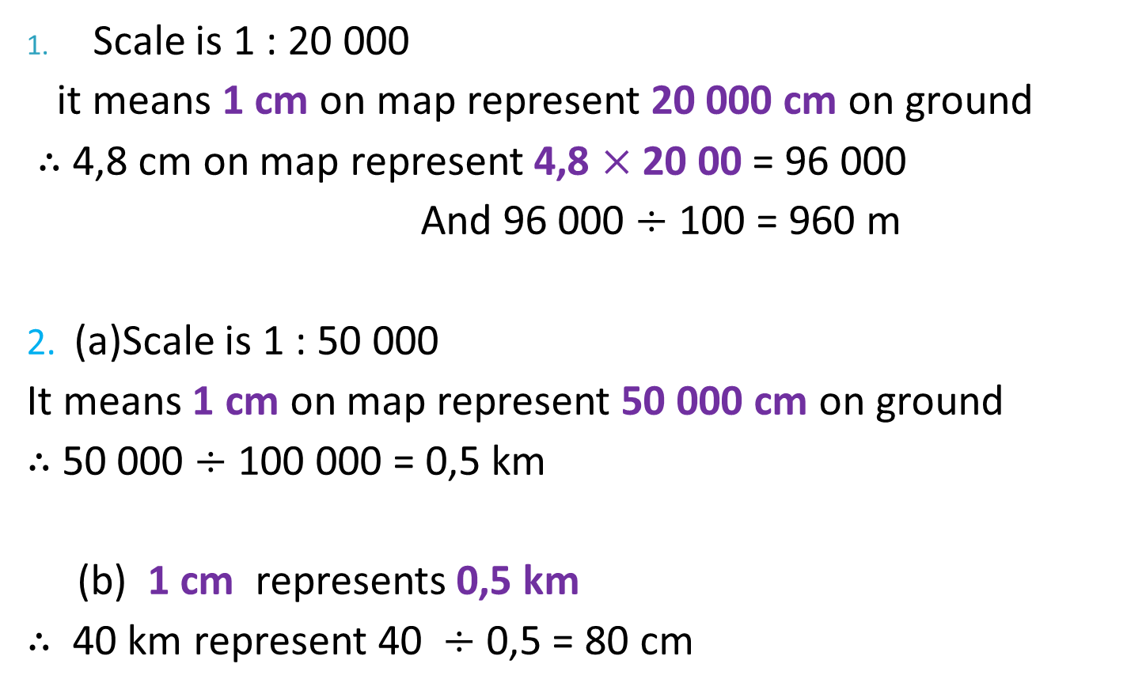
Solutions: Example 1
Scale is 1 : 20 000
it means 1 cm on map represent 20 000 cm on ground
$∴$ 4,8 cm on map represent 4,8 $×$ 20 00 = 96 000
And 96 000 $÷$ 100 = 960 m
2. (a)Scale is 1 : 50 000
It means 1 cm on map represent 50 000 cm on ground
$∴$ 50 000 $÷$ 100 000 = 0,5 km
(b) 1 cm represents 0,5 km
$∴$ 40 km represent 40 $÷$ 0,5 = 80 cm

Slide 7
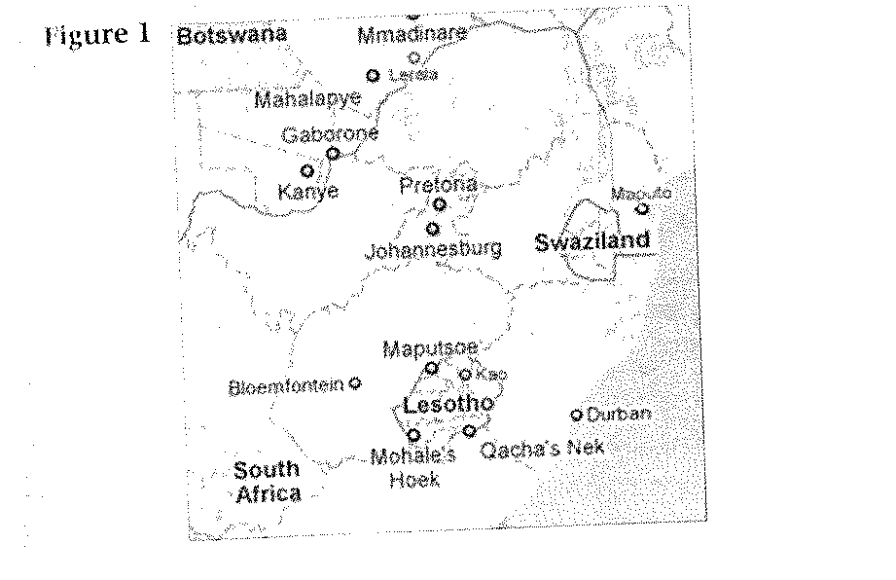
Activity 1:
Given that the number scale for part of the map of South Africa in figure 1 is 1 : 20 000 000, use your ruler to measure the map distances and answer questions in the next slide:

Slide 8
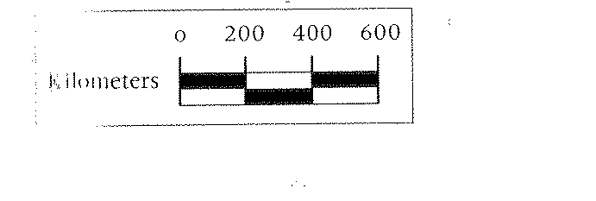
Activity 1:
Calculate the actual distance from Durban to Johannesburg travelling by air (aeroplane in a straight line).
(b) Calculate the actual distance from Gaborone to Maputo
(c) Use the bar scale below to calculate the distance between Bloemfontein and Kanye.

Slide 9
Solution: Activity 1
(a) Using a ruler, the distance from Durban to Johannesburg = 32 mm
In scale 1 : 20 000 0000
then, 1 mm = 20 000 000 mm
= 32 km
$∴$ 1mm = 20 km
And 32 mm = 20 $×$ 32
= 640 km
(b) Using a ruler, the distance from Gaborone to Maputo = 43 mm
In scale 1 : 20 000 0000
then, 1 mm = 20 000 000 mm
= 20 km
$∴$ 1mm = 20 km
And 43 mm = 20 $×$ 43
= 860 km

Slide 10
Solution: Activity 1
(c) According to the bar scale 1 cm = 200 km
Using a ruler, the distance between Kanye and Bloemfontein
= 3 cm
= 3 $×$ 200 km
= 600 km

Slide 11
Example: 2
A particular map shows a scale of 1 cm : 500 000 cm. What would the map distance (in cm) be if the actual distance on land is 25 km?

Slide 12
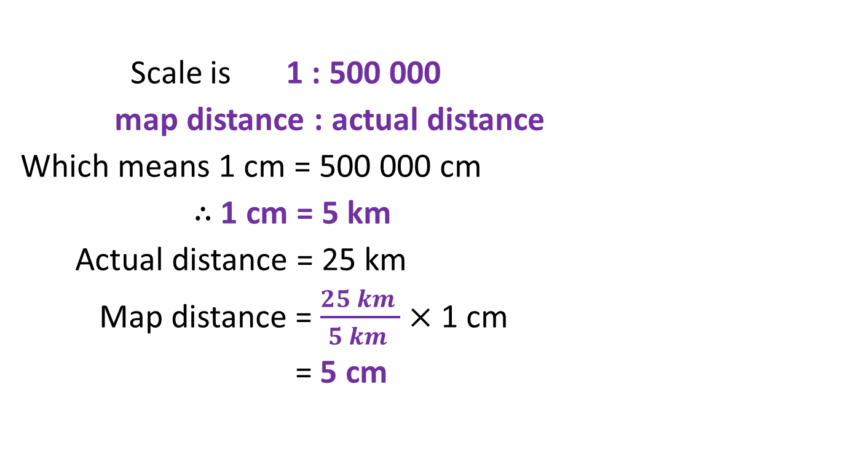
Solution: Example 2
Scale is 1 : 500 000
map distance : actual distance
Which means 1 cm = 500 000 cm
$∴$ 1 cm = 5 km
Actual distance = 25 km
Map distance = $\frac{25 km }{5 km }$ $×$1 cm
= 5 cm

Slide 13
Activity: 2
Now consider the following office floor space with desks and a passage along them to answer questions in next slide.

Slide 14
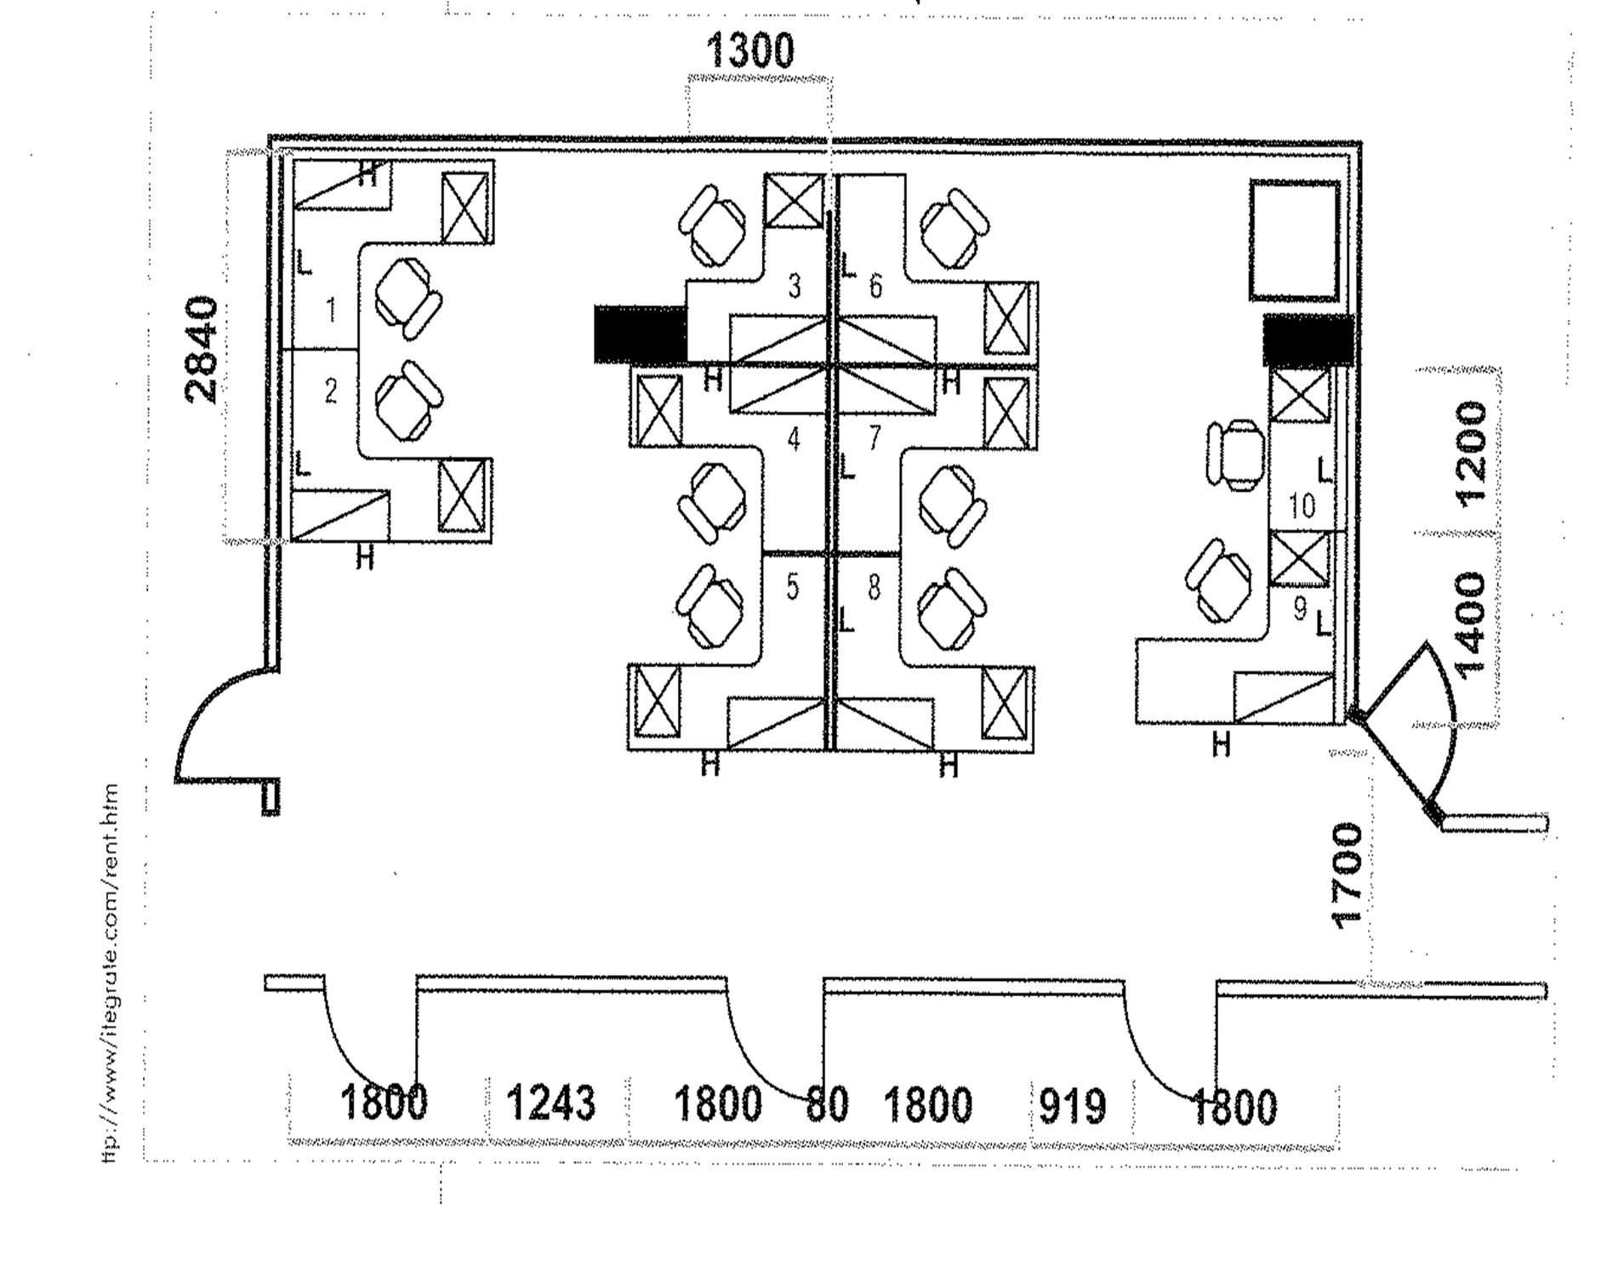

Slide 15
Activity: 2
You are also given that all the measurements shown in the diagram are actual and in millimetres. The number scale of the floor plan of the office is 1 : 100.
What is the actual width of the passage in metres.
Determine the plan width of the passage.
If the sides of the desks indicated by L are the widths of the desks, then work out the plan width of each of desks 1 and 2 in cm.
Now, work out the plan width in cm of the space between the set of desks 1 and 2 and another set of desks 3, 4 and 5.

Slide 16
Solution: Activity 2
(a) Actual width = 1 700 mm (given in diagram)
= 1,7 m (from small to large units divide $\frac{1700}{1000}$)
(b) Scale is 1 : 100
plan distance : actual distance
Which means 1 cm = 100 cm
$∴$ 1700 mm = $\frac{1700 }{1000}$
= 1,7 cm
The plan width of passage will be 1,7 cm

Slide 17
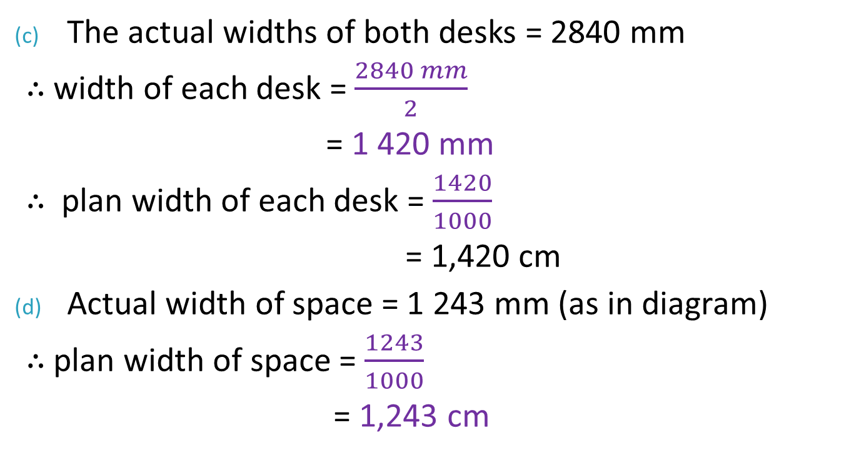
Solution: Activity 2
The actual widths of both desks = 2840 mm
$∴$ width of each desk = $\frac{2840 mm}{2}$
= 1 420 mm
$∴$ plan width of each desk = $\frac{1420}{1000}$
= 1,420 cm
Actual width of space = 1 243 mm (as in diagram)
$∴$ plan width of space = $\frac{1243}{1000}$
= 1,243 cm

Slide 18
Final Assessment Questions 1-10 Question 1
A map of South Africa has a scale of 1 : 20 000 000. This scale means that 1 cm on the map = ____cm on the ground.
20 000
200 000
20 000 000
20

Slide 19
Question 2
A map of South Africa has a scale of 1 : 20 000 000. This scale means 1 cm on the map = ____km on the ground.
2 000
20
200 000
200

Slide 20
Question 3
Simplify the scale 5 cm : 2 km to a scale that will be easy to work with
1 : 4 000
1 : 40 000
1 : 400 000
1 : 8 000

Slide 21
Question 4
Which of the scales below indicate the small scale map:
1 : 1 000 000
1 : 625 000
1 : 50 000
1 : 10 000

Slide 22
Question 5
Calculate the distance, in kilometres on the ground, of 0,8 cm length which was measured on a map with a scale of 1 : 50 000
0,4 cm
0,8 km
0,4 km
0,8 m

Slide 23
Question 6
Calculate the length (in centimetres) on a map with a scale of 1 : 50 000 of the actual distance of 6 km
12 cm
12 mm
24 cm
0,24 cm

Slide 24
Question 7
Police have been asked to patrol a riot that is 0,9 km from the Mayor’s residence. How far away from the Mayor’s residence is the riot on a map of 1 : 15 000? Give your answer in centimetres.
6 m
12 m
12 cm
6 cm

Slide 25
Question 8
When maps or plans are reduced or enlarged, the _____ scale become invalid.
Enlarged Scale
Bar Scale
Number Scale
Reduced Scale

Slide 26
Question 9
A bed as seen from the top is 190 cm long and 90 cm wide. Calculate the dimensions of a bed if it is drawn to the scale of 1 : 25.
length = 7,6 cm; width = 3,6 cm
length = 72 mm; width = 36 mm
length = 36 mm; width = 72 mm
length = 19 cm; width = 9 cm

Slide 27
Question 10
A particular map shows a scale of 1 cm : 10 km. What would the map distance be (in cm) if the actual distance is 24 km?
2,4 cm
24 cm
240 cm
48 cm

Slide 28
Solutions Final Assessment Questions
C
D
B
A
C
A
D
C
B
A

