Slide 1
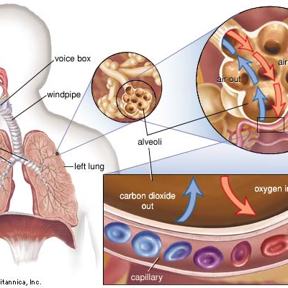
Life sciences Grade 11 CAPS structured, clear, practical - Helping teachers unlock the power of NCS
KNOWLEDGE AREA:
Life Process in Plants and Animals.
TOPIC 5.3: Gas Exchange
Gas Exchange , Gas Transport, Disease and Allergies of the Gas Exchange System in Humans

Slide 2
Summary of Presentation
Gas Exchange at Lungs
Gas Exchange at Tissues
Oxygen Availability at High Altitudes
Diseases and Allergies of the Gas Exchange System
Transport of Oxygen
Transport of Carbon dioxide

Slide 3
GAS exchange at the lungs
At this point inhalation has occurred.
Air rich in oxygen is now in the alveoli.
The air now has to enter the blood capillaries and then be transported to the cells.
Therefore we shall now look at the gas exchange at lung level and then the movement of oxygen to the cells.

Slide 4
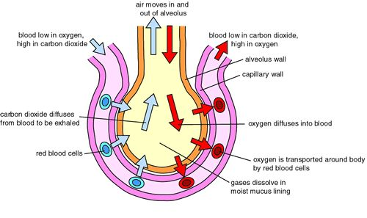
GAS exchange at the lungs
The diagram below shows us the events that occur during gas exchange at the lungs
Gaseous Exchange at the alveoli

Slide 5
GAS exchange in the lungs
Now lets explain what happens during gas exchange at the lungs in point form.
Blood arriving at the lung is rich in carbon dioxide.
This is so because the blood is coming from the cells where cellular respiration has occurred and large amounts of carbon dioxide were produced.
The branches of the pulmonary artery form the capillaries that carry this deoxygenated blood.
Inside the alveoli there is a large amount of oxygen and very little carbon dioxide.

Slide 6
GAS exchange at the lungs
This means that there is a region of high concentration of carbon dioxide in the capillaries around the alveoli and a region of low concentration of carbon dioxide within the alveoli.
Therefore carbon dioxide moves from the capillaries into the alveoli by diffusion.
The dissolved carbon dioxide diffuses through the walls of the capillaries and the squamous epithelial lining of the alveoli.
At this point there is a high concentration of oxygen in the alveoli and a low concentration of oxygen in the blood capillaries around the alveoli.

Slide 7
GAS exchange at the lungs
The oxygen dissolves in the thin film of water lining the alveoli.
The oxygen then diffuses through the squamous epithelial lining of alveoli and through the endothelium of the blood capillary.
The blood in the capillary now has a high concentration of oxygen.
The capillary now carries the oxygenated blood to the cells.

Slide 8
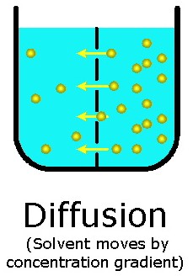
Terminology:
TERM: Diffusion
DEFINITION: The movement of a substance (gas or liquid) from a region of high concentration to a region of low concentration until equilibrium is reached | USE IN SENTENCE: Oxygen diffuses from the capillary into the cell, while carbon dioxide diffuses out of the cell and into the blood capillary.

Slide 9
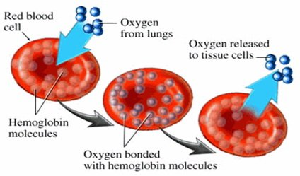
Terminology:
TERM: Oxygenated Blood
DEFINITION: Blood with a high concentration of oxygen and a low concentration of carbon dioxide | USE IN SENTENCE: The pulmonary vein carries oxygenated blood to the heart from the lungs.

Slide 10
Terminology:
TERM: Deoxygenated blood
DEFINITION: Blood that has a high concentration of carbon dioxide and a low concentration of oxygen. | USE IN SENTENCE: The pulmonary artery carries deoxygenated blood from the heart to the lungs.

Slide 11
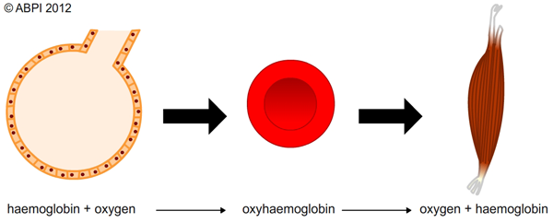
Transport of oxygen
The oxygen is now in the blood capillaries.
Most of the oxygen combines with the haemoglobin to form oxyhaemoglobin.
A small amount of oxygen is goes into solution in the blood plasma.
Formation of oxyhaemoglobin

Slide 12
Transport of oxygen
The oxygen is therefore transported as oxyhaemoglobin and in solution to the heart and from there to the rest of the body.

Slide 13
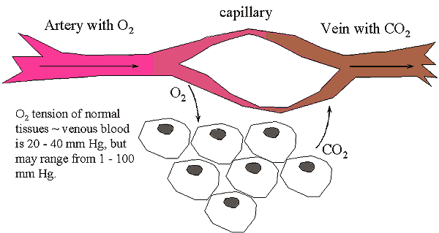
Gas exchange at the tissues
The diagram below shows what happens during gas exchange at tissue level.
Gaseous Exchange at Tissue Level

Slide 14
Gas exchange at the tissues
Now the oxygenated blood has arrived at the tissues.
The oxyhaemoglobin breaks up into oxygen and haemoglobin.
The capillaries have a high concentration of oxygen and a low concentration of carbon dioxide.
While the cells have a high concentration of carbon dioxide and a low concentration of oxygen.
The oxygen therefore diffuses through the endothelial wall of the capillary and into the tissue fluid.
From the tissue fluid the oxygen diffuses into the cells.

Slide 15
Gas exchange at the tissues
The carbon dioxide moves in the opposite direction.
The carbon dioxide diffuses out of the cell and through the endothelial wall of the capillaries into the capillaries.
The blood in the capillaries now has a high concentration of carbon dioxide.
The capillaries now have deoxygenated blood.

Slide 16
Transport of carbon dioxide
Carbon dioxide is transported in 3 ways through the human body.
The 3 ways are:
Some carbon dioxide combines with haemoglobin to form carbhaemoglobin.
Most of the carbon dioxide reacts with water in the blood plasma to form carbonic acid, which then turns into bicarbonate ions.
Some of the carbon dioxide dissolves in blood plasma.

Slide 17
Availability of oxygen at high altitudes
As the altitude increases the air becomes less dense.
This means that there is less oxygen at higher altitudes.
Research has shown that people who live at high altitudes breathe more deeply and quickly.
They also have more red blood cells.
This increases their oxygen carrying capacity.
People that move to high altitudes after living at low altitudes are able to adapt because the body is able to produce more red blood cells.

Slide 18
Availability of oxygen at high altitudes
This information is used by athletes who compete at high altitude.
They live and practice at high altitude for a short while before the competition.
The extra red blood cells enables their bodies to absorb more oxygen.
Therefore more cellular respiration occurs.
This results in more energy being released.

Slide 19
Diseases and allergies affecting the human gas exchange system
ALLERGIES:
When a person becomes sick when exposed to certain animals or certain types of food we say that they are allergic.
The substances that they are allergic to are called allergens.

Slide 20
Diseases and allergies affecting the human gas exchange system
Some examples of allergens are…
Pollen grains
Spores
Feathers
Animal fur or skin
Some foods and
Chemicals

Slide 21
Terminology:
TERM: Allergic
DEFINITION: When a person becomes sick when exposed to certain animals or certain types of food | USE IN SENTENCE: Not all people are allergic to the fur of animals.

Slide 22
Diseases and allergies affecting the human gas exchange system
People who are allergic have a natural tendency or have inherited the tendency to develop allergies.
When the allergens enter the body of such people we say that they have an allergic reaction or an allergic attack.
The allergic reaction can be mild, e.g. lumps may appear on the skin and these may disappear after some time without treatment.
However the allergic reaction can be serious.
In this case, medical treatment and or hospitalization may be necessary.

Slide 23
allergies affecting the human gas exchange system: Asthma
Causes:
Narrowing of the air passages because of an allergic reaction to pollen, dust, feathers, certain chemicals and some food.
Viral infections such as colds.
Symptoms:
Breathlessness
Cough
wheezing

Slide 24
allergies affecting the human gas exchange system: Hay Fever
Causes:
Irritation of the mucous membranes of the nasal passages caused by
a) spores and
b) Pollen grains of mould
Then the immune system produces histamines.
These histamines protect the body, but they produce some symptoms.
Symptoms:
Sneezing
Runny, blocked and itchy nose
Itchy and watery eyes

Slide 25
terminology
TERM: Disease
DEFINITION: when the normal functioning of an organism is upset or changed by infections, environmental factors or inborn defects. | USE IN SENTENCE: TB is a disease that causes damage to the lungs.

Slide 26
Diseases affecting the human gas exchange system
Diseases occur when the normal functioning of an organism is upset or changed by infections, environmental factors or inborn defects.
These infections can be caused by bacteria or viruses.
Environmental factors that can cause diseases are things like pollution or even poor nutrition.

Slide 27
Diseases affecting the human gas exchange system
Example of inborn defects that can cause diseases is a poorly functioning kidney.
Some example of disease that affect the gas exchange system of humans are:
Lung cancer
Tuberculosis
Bronchitis
Pneumonia
Pleurisy
Emphysema
Common cold and influenza

Slide 28
Diseases affecting the human gas exchange system: Lung Cancer
Causes:
Toxic substances in the air
Smoking
Symptoms:
Shortness of breath
Blood in the sputum

Slide 29
Diseases affecting the human gas exchange system: Bronchitis
Causes:
Bacterial infections may cause inflammation of the mucous membranes.
This can also be caused by complications of other diseases such as colds, flu, measles and sinus infections.
Symptoms:
Coughing up phlegm
Mild fever

Slide 30
Diseases affecting the human gas exchange system: Emphysema
Causes:
Toxics substances in the air
Smoking
Complication from bronchitis and asthma
These cause enlargement of the air sacs, this in turn causes the air sacs to lose their elasticity and some of their blood supply.
This leads to ineffective exchange of gases.
Symptoms:
Short breath
Wheezing
Cough with thick, sticky sputum

Slide 31
Diseases affecting the human gas exchange system: Tuberculosis
Causes:
By 2 bacteria viz:-
Mycobacterium tuberculosis and
Mycobacterium bovis
Symptoms:
Blood in the sputum
Coughing
Loss of appetite
Short breath
Tiredness

Slide 32
Terminology:
TERM: Active TB
DEFINITION: The type of TB where person feels sick and it can be spread to other people | USE IN SENTENCE: A person with active TB must get immediate medical attention so that it does not spread to other people.

Slide 33
Terminology:
TERM: Latent TB
DEFINITION: The type of TB where the patient does not feel sick and this TB does not spread to other people. | USE IN SENTENCE: A person with latent TB must seek medical attention or the latent TB will develop into active TB.

Slide 34
Diseases affecting the human gas exchange system: Active Tuberculosis
Causes:
Caused by a bacteria called Myobacterium tuberculosis.
This bacteria attacks the lungs.
But the bacteria can attack any part of the body, such as kidney, brain and spinal cord.
The disease can lead to death if it is not properly treated.

Slide 35
Diseases affecting the human gas exchange system: TB Transmission
TB of the brain, kidney and spinal cord is not infectious.
However if a person has active TB of the lungs or throat the disease can spread.
The disease is spread when this person coughs or sneezes. This happens because the TB bacteria gets into the air when the person coughs or sneezes.
The TB bacteria the enters the body of other people when they breathe in.
The bacteria then settles in their lungs where it grows and develops.

Slide 36
Diseases affecting the human gas exchange system: TB Transmission
Once the TB bacteria is in the lungs it can enter the blood stream.
Once the TB bacteria is in the blood stream it can move to other parts of the body, like the kidney, brain and spinal cord.
Remember you usually become infected with TB if you spend a lot of time, every day with a person with active TB.
Therefore the family members, friends and co-workers of a person with active TB usually become infected with the disease.
Over crowding and poor sanitation increases the rate at which TB is spread.

Slide 37
Diseases affecting the human gas exchange system: TB Symptoms
Weakness or fatigue
Weight loss
Chills
Fever
Sweating at night

Slide 38
Diseases affecting the human gas exchange system: TB Symptoms
If the TB is in the lungs, then the following symptoms also or occur in addition to those above. These are…
Bad cough that lasts for more than 2 weeks
Chest pains
Coughing up blood with the sputum.
Action of the Immune System:
The immune system is able to fight the disease.
Then the bacteria no longer grows.
The bacteria becomes inactive.
This type of TB is called latent TB.

Slide 39
Diseases affecting the human gas exchange system: Latent Tuberculosis
People with latent TB have the following experience:
Patient does not feel sick.
This TB does not spread to other people.
Sputum test is negative.
Normal chest x-ray.
But skin test is positive.
There are no symptoms.

Slide 40
Diseases affecting the human gas exchange system
However these people can develop active TB if the latent TB is not treated.
Some people with latent TB never develop active TB.
But in people with weak immune systems the inactive TB can develop into active TB.

Slide 41
Diseases affecting the human gas exchange system
Effects of the TB bacteria on the Body
It destroys the body tissue when it attacks the body.
If it settles in the lung, then it grows a hole in the lung.
Person’s affected by the disease:
TB is an opportunistic disease.
It attacks when the immune system is weak. These people would develop active TB.
If the bacteria enters the body of a person with a strong immune system then the immune system fights the bacteria.
The bacteria becomes inactive and the person develops Latent TB.

Slide 42
Diseases affecting the human gas exchange system
People who develop active TB usually are:
Babies and young children because their immune systems are still developing.
Poor people because they have weak immune system due to a lack of good nutrition.
People with HIV/AIDS.
Drug abusers.
People with other diseases e.g. Diabetes.
Organ transplant patients.

Slide 43
Diseases affecting the human gas exchange system: Tests for TB
There are 3 tests for TB.
They are:
X-rays
TB skin tests
Tissue Culture
X-RAYS:
The lungs are x-rayed.
If the person is infected with TB then the holes in the lungs are visible on the x-ray.
These holes are visible as patches.

Slide 44
Diseases affecting the human gas exchange system
TB SKIN TEST:
This is also called the Mantoux test.
A small amount of a liquid called tuberculin in injected into the skin of the lower arm.
A positive reaction to the test means that the TB bacteria is in your body and you could have latent TB.

Slide 45
Diseases affecting the human gas exchange system
TISSUE CULTURE:
A sample of phlegm is collected.
It is then grown (cultured) in the laboratory.
The culture is then examined under the microscope, to look for the TB bacteria.
If the TB bacteria are present then the person has TB.
This test can take about 4 to 6 weeks.

Slide 46
Diseases affecting the human gas exchange system
Vaccination against TB:
TB can be prevented with the use of a vaccine called BCG.
The BCG vaccines was developed by two scientists called Calmette and Guerin.
They were French scientists.

Slide 47
Diseases affecting the human gas exchange system
Treatment of TB:
People with active TB can be treated with medication.
The medication works in 3 ways.
These are:
They cure the active TB infection.
Stop the latent TB from developing into active TB in patients with latent TB.
It also prevents the spread of the disease from person to person.

Slide 48
Diseases affecting the human gas exchange system
The type of medication and the amount administered differs from person to person.
It depends on factors like age, health of the infected person, the state of their immune system, the organ infected and how advanced the disease is.
Despite the availability of treatment the disease has a very low cure rate.

Slide 49
Diseases affecting the human gas exchange system
The main reason for this low cure rate is that patients do not complete their treatment.
They feel well after just a few doses and stop their medication.
It is too expensive to keep them in hospital for the duration of their treatment.
When patients stop their medication before the treatment is complete, the can become re-infected.
This is called a relapse.
There is also a very great danger that the TB can become drug resistant.

Slide 50
Diseases affecting the human gas exchange system
This means that the medication will not be able to kill the bacteria.
In order to prevent this problem a new therapy called DOT or DOTS was established.
This therapy ensures that patients complete their treatment and in this way prevent drug-resistant TB.
DOT is Directly Observed Therapy.
DOTS is Directly Observed Therapy Short Course.

Slide 51
Diseases affecting the human gas exchange system
In this therapy health workers meet the patient and watch them take their medication everyday until their treatment is complete!
The meeting place is usually the patients home or place of work.
The advantage of this therapy is that it eliminates the cost of a hospital stay, while at the same time ensuring the patient completes their treatment.
This prevents drug resistant TB.

Slide 52
Activity 1: Essay
Write an essay in which you define the terms active and latent TB and explain the differences between them. Finally explain why is it is not advisable to ignore latent TB.
17
Synthesis: 3
Total: 20

Slide 53
Smoking: The harmful effects of smoking…
It reduces the amount of oxygen available to different parts of the body.
This happens because smoking causes the blood vessels to narrow.
It also happens because carbon monoxide is released during smoking. The carbon monoxide attaches to the haemoglobin more readily than oxygen. Therefore the carbon monoxide instead of oxygen is carried to the cells, because fewer haemoglobin is available to transport oxygen.

Slide 54
Smoking: The harmful effects of smoking…
This is turn causes the heart to beat faster to pump the available oxygen to all parts of the body. Therefore smokers often experience heart attacks.
Nicotine is an addictive drug found in cigarettes. It stimulates the nervous system. It also increases blood pressure and in turn makes the heart work harder. Another reason why smokers are more likely to suffer from heart disease than non-smokers.

Slide 55
Smoking: The harmful effects of smoking…
During smoking tar is released. Tar is a carcinogen. It irritates the internal lung tissue. This can lead to lung cancer if the individual is a long time smoker.
Pregnant women who smoke give birth to babies with a smaller birth weight. This occurs because once again the carbon monoxide reduces the amount of oxygen available to the baby. This can also lead to difficulties during childbirth.

Slide 56
Smoking: The harmful effects of smoking…
People who do not smoke also experience the unpleasant and sometimes harmful effects of smoking.
These are…
Smoke in the air stings the eyes
Headaches
Sore throats
Remember if non smokers are exposed to cigarette smoke over a long period of time they too can develop all the harmful effects of smokers.

Slide 57
Smoking: Legislation in South Africa
There are many smoking laws is South Africa. We will look at only a few, these are…
You cannot smoke in the car with a child under 12.
You may not smoke in partially enclosed public places like patio etc.
You cannot smoke on the premises that are used for commercial childcare activities.
You cannot sell or be a supplier of cigarettes if you are under 18.
Sweets or toys that look like cigarettes are banned.

Slide 58
Respiratory emergencies:
ARTIFICAL RESPIRATION:
A drug overdose, drowning or an accident may cause a person to stop breathing.
Then artificial respiration becomes necessary to keep the lungs working in order to supply the body with oxygen until medical assistance arrives.
Artificial respiration can occur through a machine called a ventilator.
Mouth-to-mouth resuscitation is one of the most common means of artificial respiration.

Slide 59
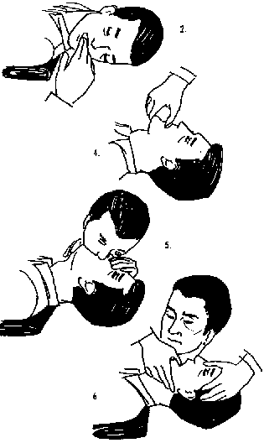
Respiratory emergencies:
Mouth-to-mouth occurs in the following way:
The patient must be fully stretched out on his back.
The neck must be lifted and supported with a pillow to ensure the head is tilted backwards.
Tightly hold the nose so that it is closed.
Blow hard into the mouth until the chest rises as in normal breathing.
Steps in CPR

Slide 60
Respiratory emergencies:
Allow the air to escape through the mouth.
This must continue in an adult at the rate of 15 breaths per minute and 20 breaths per minute in a child.
This may have to continue for a long time until the patient is breathing on their own.

Slide 61
Terminology:
Diffusion: The movement of a substance (gas or liquid) from a region of high concentration to a region of low concentration until equilibrium is reached
Oxygenated Blood: Blood with a high concentration of oxygen and a low concentration of carbon dioxide
Deoxygenated blood: Blood that has a high concentration of carbon dioxide and a low concentration of oxygen.
Haemoglobin: pigment that is used to transport gases.
Oxyhaemoglobin: the compound that is formed when oxygen is combined with haemoglobin during the transport of oxygen.

Slide 62
Terminology:
Carbhaemoglobin: the compound that is formed when carbon dioxide combines with haemoglobin so that it can be transported to the lungs.
Altitude: refers to the height of the land above sea level.
Allergic: When a person becomes sick when exposed to certain plants, animals or certain types of food.
Allergen: The substances that cause an allergic reaction in some people.
Allergic reaction or attack: occurs when an allergen enters the body of an allergic person.

Slide 63
Terminology:
Disease: when the normal functioning of an organism is upset or changed by infections, environmental factors or inborn defects.
Myobacterium tuberculosis: bacterium that causes TB.
Active TB: the type of TB where person feels sick and it can be spread to other people
Latent TB: the type of TB where the patient does not feel sick and this TB does not spread to other people.
Opportunistic disease: a disease that attacks when the immune system is in a weakened state.

Slide 64
Question 1
Blood from the tissues arriving at the alveoli is…
A. Deoxygenated
B. Oxygenated
C. Rich in oxygen
D. B and C

Slide 65
Question 2
Oxygen enters the capillaries around the alveoli through the process of…
A. Assimilation
B. Osmosis
C. Diffusion
D. Active transport

Slide 66
Question 3
The blood cell that is involved in the transport of gases is…
A. Red blood cell
B. White blood cell
C. Blood platelets
D. None of the above

Slide 67
Question 4
The oxygen is transported through the body as…
A. Bi carbonate ions
B. Oxyhaemoglobin
C. Carbhaemoglobin
D. None of the above

Slide 68
Question 5
Carbon dioxide is transported throughout the body as…
A. Bi carbonate ions
B. Solution in the blood plasma
C. Carbhaemoglobin
D. All of the above

Slide 69
Question 6
The movement of carbon dioxide at the tissues is…
A. From the blood capillary to the cell
B. Through the endothelial lining of the blood capillary into the tissue fluid and then into the cell
C. Through the cell membrane into the tissue fluid and then through the endothelial lining of the capillary
D. From the blood capillary into the alveoli

Slide 70
Question 7
The movement of oxygen at the tissues is…
A. From the blood capillary to the cell
B. Through the endothelial lining of the blood capillary into the tissue fluid and then into the cell
C. Through the cell membrane into the tissue fluid and then through the endothelial lining of the capillary
D. From the blood capillary into the alveoli

Slide 71
Question 8
Which of the following statements are true about the movement of oxygen during gas exchange at the alveoli…
A. Oxygen dissolves in a film of moisture before diffusion
B. Oxygen moves form the blood capillaries into the alveoli
C. Oxygen does not need to be in a dissolved state before diffusion can occur
D. Oxygen moves into the alveoli by osmosis

Slide 72
Question 9
Which of the following is not true about the transport of carbon dioxide?
A. Combines with haemoglobin to form carbhaemoglobin
B. Can be transported in solution
C. Can be transported as sodium ions
D. Can be transported as bicarbonate ions

Slide 73
Question 10
At the start of gas exchange in the lungs there is…
A. High concentration of oxygen in the alveoli
B. High concentration of oxygen in the blood capillaries
C. Low concentration of oxygen in the alveoli
D. High concentration of carbon dioxide in the alveoli

Slide 74
Question 11
Oxygen gas is transported…
A. As bicarbonate ions
B. By the pulmonary artery to the heart
C. By the pulmonary veins to the heart
D. To the alveoli by capillary branches of the pulmonary artery

Slide 75
Question 12
A runny, blocked and itchy nose are symptoms of…
A. TB
B. Hay fever
C. Asthma
D. Bronchitis

Slide 76
Question 13
Inflammation of the mucus membrane lining the air passages is the cause of…
A. TB
B. Hay fever
C. Asthma
D. Bronchitis

Slide 77
Question 14
Allergic reaction to pollen or dust that results in a narrowing of the air passage is a cause of…
A. TB
B. Hay fever
C. Asthma
D. Bronchitis

Slide 78
Question 15
Cavities and scar tissue in the lungs is a cause of…
A. TB
B. Hay fever
C. Asthma
D. Bronchitis

Slide 79
Question 16
Latent TB differs from active TB because…
A. It makes the patient sick
B. It is not infectious
C. It is infectious
D. It can be passed from person to person

Slide 80
Question 17
The carcinogen found in cigarette smoke is…
A. Carbon dioxide
B. Carbon monoxide
C. Tar
D. Nicotine

Slide 81
Question 18
The stimulant found in cigarettes is…
A. Carbon dioxide
B. Carbon monoxide
C. Tar
D. Nicotine

Slide 82
Question 19
The substance in cigarette that outcomes oxygen for attachment to the gas carrying pigment is…
A. Carbon dioxide
B. Carbon monoxide
C. Tar
D. Nicotine

Slide 83
Question 20
The substance found in cigarettes that causes high blood pressure is…
A. Carbon dioxide
B. Carbon monoxide
C. Tar
D. Nicotine

Slide 84
Solutions to final assessment questions
A
C
A
B
D
C
B
A
C
A
C
B
D
C
A
B
C
D
B
D

Slide 85
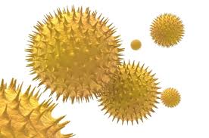
Terminology:
TERM: Allergen
DEFINITION: The substances that cause an allergic reaction in some people. | USE IN SENTENCE: Some examples of food allergens are nuts, fish and milk
Pollen allergen

