Slide 1
MATHEMATICAL LITERACY GRADE 10 CAPS
TOPIC 3: Measurement
Section 3.5: Calculating perimeter and area

Slide 2
Measurement
The following sections will be covered:
3.1 Conversions
3.2 Measuring length and distance
3.3 Measuring weight
3.4 Measuring temperature
3.5 Calculating perimeter and area

Slide 3
Perimeter and Area
In section 3.5, Learners should be able to determine:
The perimeter of squares, rectangles and circles.
The area of squares, rectangles and circles.

Slide 4
Perimeter and circumferences
The perimeter of a shape is the total distance around the boundary of the given shape.
Circumference is the perimeter of a circle.
The units of perimeter are the units of length:
mm, cm; m; km

Slide 5
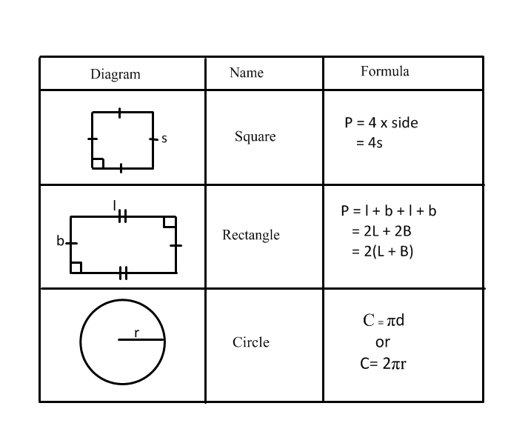
Perimeter of plane shapes

Slide 6
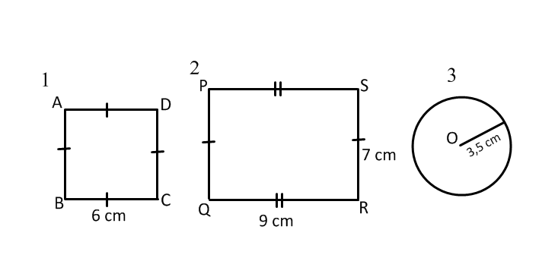
Calculating Perimeter

Slide 7
Perimeter of a Square
P = AB + BC + CD + DA
= 6 cm + 6cm + 6 cm + 6 cm
= 24 cm
or
P = 4s = 4 x 6 cm
= 24 cm
Sum of all side
Using formula for perimeter of a square

Slide 8
Perimeter of a Rectangle
Perimeter = PQ + QR + RS + SP
= 7 cm + 9 cm + 7 cm + 9 cm
= 32 cm
or
P = 2(L + B)
= 2(9 cm + 7 cm)
= 2(16 cm)
= 32 cm
Sum of sides
Using formula

Slide 9
Perimeter of a Circle
3. C = 2πr (π = 3,14)
= 2 x 3,14 x 3,5 cm
= 21,98 cm

Slide 10
Area
Area is the amount of space that a 2- dimensional shape occupies.
The units of area are:
mm²
cm²
m²

Slide 11
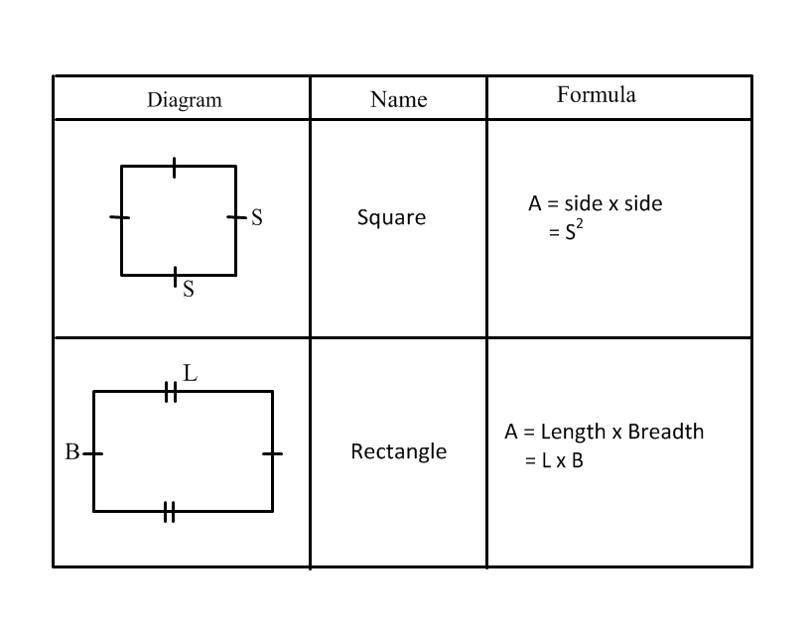
Area of plane shapes

Slide 12
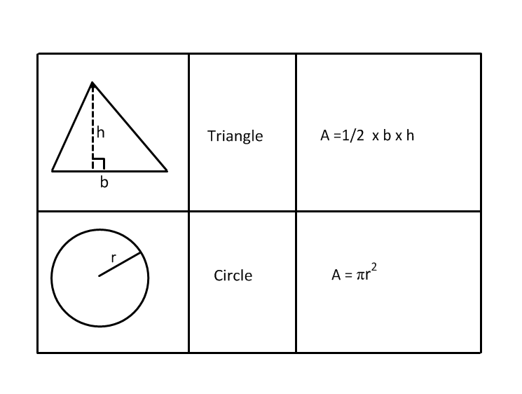
Area of plane shapes

Slide 13
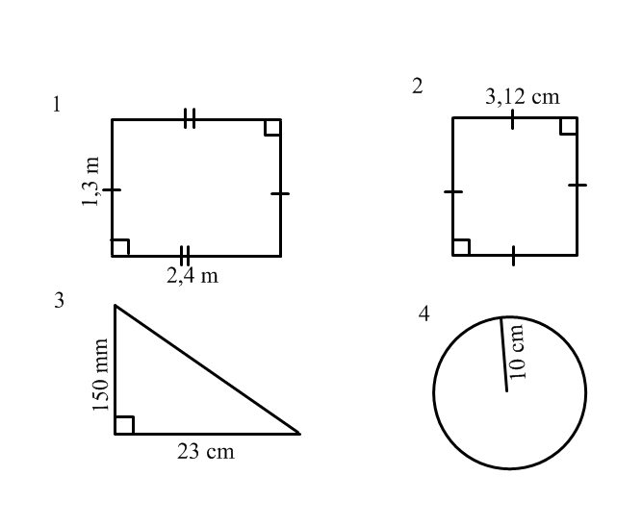
Calculating area
Calculate the area of the shapes below; make all units the same where necessary.

Slide 14
Area of a rectangle/square
Area of a rectangle = L x B
= 2,4 m x 1,3 m
= 3,12 m²
Area of a square = S²
= (3,12 cm)²
= 9,73 cm²

Slide 15
Area of a triangle/circle
3. Area of as triangle = 0,5 x b x h
= 0,5 x (150 ÷ 10 cm) x 23 cm
= 173 cm²
4. Area of a circle = πr²
= 3,14 x (10cm)²
= 314 cm²
Convert to the same units

Slide 16
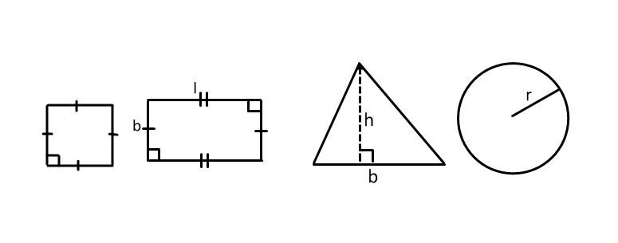
Final Assessment Questions

Slide 17
Question 1
The perimeter of rectangle with length = 21 cm and breadth = 12 cm is
33 cm
66 cm
225 cm
252 cm

Slide 18
Question 2
The circumference of a circle with a diameter of 32 mm is
201,1 mm
100,54 mm
50,27 mm
25,14 mm

Slide 19
Question 3
Triangle ABC has sides, AB = 7 cm; BC = 6 cm; AB = 17 cm. Its perimeter is
14 cm
23 cm
24 cm
30 cm

Slide 20
Question 4
A square table top has a perimeter of 8 m. The length of one of its sides is
2 m
2,5 m
4 m
8m

Slide 21
Question 5
Andy cut out a right angled triangular piece from a cloth. The height of the triangle is 350 mm and the base is 21 cm long. The area of the triangle is
367,5 cm²
735 cm²
1837 cm²
3675 cm²

Slide 22
Question 6
Calculate the area of circular sand pit with a radius of 12, 5m
A. 39,28 m²
B. 78,55 m²
C. 490,94 m²
D. 1963,75m²

Slide 23
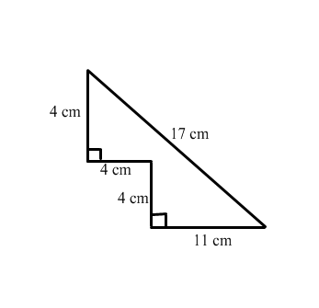
Question 7
The area of the shape is
40 cm²
60 cm²
68cm²
127,5

Slide 24
Question 8
The Perimeter of the shape is
32 cm
36 cm
40 cm
60 cm

Slide 25
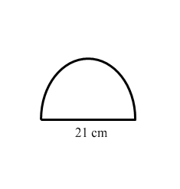
Question 9
The area of the semi-circle is, ( n = 3,14)
33 cm²
66 cm²
346,41 cm²
1385,62 cm²

Slide 26
Question 10
The perimeter of the semi- circle is, (n = 3,14)
32,99 cm
65,99cm
53,99 cm
86,99 cm

Slide 27
Solutions Final Assessment Questions
B
B
D
A
A
C
B
C
C
D

