Slide 1
MATHEMATICAL LITERACY GRADE 10 CAPS
TOPIC 3: Measurement
Section 3.4: Measuring Temperature

Slide 2
Measurement
The following sections will be covered:
3.1 Conversions
3.2 Measuring length and distance
3.3 Measuring weight
3.4 Measuring temperature
3.5 Calculating perimeter and area

Slide 3
Measuring Temperature
Temperature is often mentioned in varying contexts. It can be an indicator of ill-health and is an important weather element.
In the home, temperature is important for heating systems such as stove, oven, iron and cooling systems such as refrigerators, air conditioner.

Slide 4
Thermometers
Different thermometers and temperature dials are used for various purposes. The units of temperature are:
Degrees Celsius (°C)
Degrees Fahrenheit (°F)

Slide 5
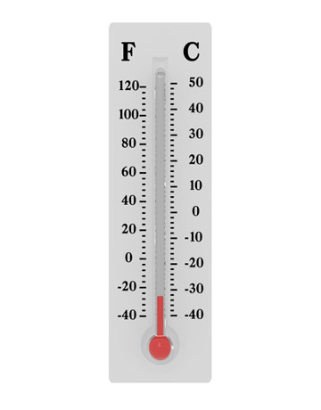
Thermometer

Slide 6
Conversion of units of Temperature
Use the conversion formula:
°F = (1,8 x °C) + 32
°C = (°F – 32) ÷ 1,8
Example:
Convert:
8 °C to °F 2. 104°F to °C
Answer:
°F = (1,8 x °C) + 32 2. °C = (°F – 32) ÷ 1,8
= (1,8x 8) + 32 = (104 – 32) ÷ 1,8
= 14,4 +32 = 72 ÷ 1,8
= 46,4 °C = 40 °C

Slide 7
Final Assessment Questions: Question1
Which of the following is a unit of temperature?
A. degrees
B. grams
C. degrees Celsius
D. thermometer

Slide 8
Question 2
The coldest temperatures is:
34 °C
B. -5 °C
C. 0 °C
D. 25 °C

Slide 9
Question 3
The temperature at 1: 00 p.m. was 19 °C, by 6:00p.m it had dropped by 8 °C. The temperature at 6:00p.m was:
A. 8 °C
B. 10 °C
C. 11 °C
D. 27 °C

Slide 10
Question 4
22 °C in °F is,
A. 32 °F
B. 48 °F
C. 49,8 °F
D. 61,6 °

Slide 11
Question 5
In a recipe the temperature setting for the oven is 266 °F. This temperature in degrees Celcius is:
A. 130 °C
B. 147 °C
C. 234 °C
D. 298 °C

Slide 12
Solutions Final Assessment Questions
B
C
D
C
A

