Slide 1
MATHEMATICAL LITERACY GRADE 10 CAPS
TOPIC 3: Measurement
Section 3.3: Measuring weight

Slide 2
Measurement
The following sections will be covered:
3.1 Conversions
3.2 Measuring length and distance
3.3 Measuring weight
3.4 Measuring temperature
3.5 Calculating perimeter and area

Slide 3
Measuring mass
In this section 3.3, learners should be able to:
Determine mass of different objects using scales
Choose the most suitable scale for measuring masses of different objects.
Select a suitable unit for measuring different objects.

Slide 4
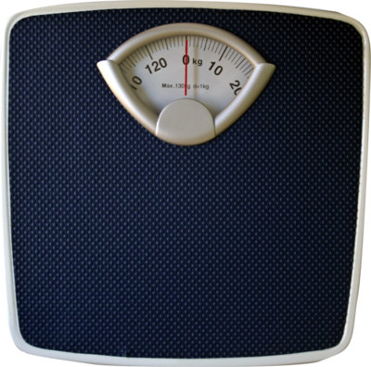
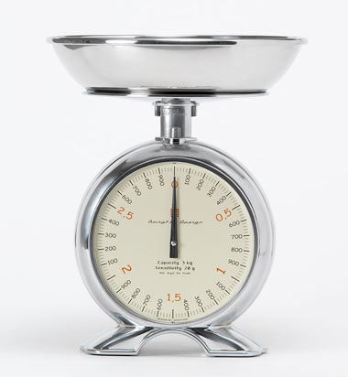
Types of Scales

Slide 5
Types of Scales
Scales vary in size and sensitivity depending on what they are designed to measure. They range from the smallest and very sensitive for measuring small masses such as mass of gold which is measured in ounces to the largest weigh bridge designed to measure very big objects like truckloads in tonnes.
Kitchen scale : unit – grams
Bathroom scale: Unit – kilograms
Weigh bridge: Unit- tonnes

Slide 6
Units of measurement
Examples: What is the suitable unit for measuring:
Mass of an apple
your body mass
Mass of lorry and its load
Answers
(a) gram
(b) kilogram
(c) tonnes

Slide 7
Activity:1
Calculate : 2,5 kg + 750 g, give answer in grams.
Calculate:
1,75kg – 925 g give answer in grams.
1 025 g x 6 give answer in kilograms.
3. The average mass of each person in a group is 75 kg. How many of them can get into a lift together safely if the maximum load it can take is not to exceed 1,03 tonnes?

Slide 8
Solutions: Activity 1
1. 2,5 kg + 750 g = 2,5 x 1 000 g + 750 g
= 2 500 g + 750 g
= 3 250 g
2. 1,75 kg – 925 g = 1,75 x 1 000 g – 925 g
= 1 750 g – 925 g
= 825 g
3. Number of people = 1, 03 t ÷ 75 kg
= 1,03 x 1000 kg ÷ 75 kg
= 1 030 kg ÷ 75 kg
= 13,7333….
= 13 people

Slide 9
Final Assessment Questions 1 – 10 Question 1
What is the most appropriate unit for measuring the mass of an elephant?
A. gram
B. milligram
C. kilogram
D. tonne

Slide 10
Question 2
Thabo is 15 years old. He measures his mass using bathroom scale, his possible mass is
A. 42 mg
B. 42 g
C. 42 kg
D. 42 ton

Slide 11
Question 3
Which scale would you choose to find the accurate mass of an apple?
A. scale designed to measure in millligrams.
B. scale designed to measure in grams
C. scale designed to measure in kilograms
D. scale designed to measure in tonnes

Slide 12
Question 4
A trolley of mass 25 kg is loaded with 14 packets of beans, each with a mass of 500 g. The total mass of the trolley and the beans is
A. 25 kg
B. 25,5 kg
C. 30 kg
D. 32 kg

Slide 13
Question 5
Manufacturer of Zimba chips had a promotion sale. On the packet “ 20% extra” was printed. The packet is normally 5 g, the mass of the packet is now
A. 5,2 g
B. 6 g
C. 7 g
D. 20 g

Slide 14
Questions 6
What is the heaviest item in food parcel containing:
2 kg sugar
1 kg beans
500 g salt
0,750 kg milk powder
Sugar
salt
beans
Milk powder

Slide 15
Question 7
The mass of a lorry is 2 tonnes. A load of builders’ sand is loaded on the lorry and the mass of the lorry and its load is 3,8 tonnes. What is the mass of the sand?
A. 7,6 t
B. 5,8 t
C. 1,9 t
D. 1,8 t

Slide 16
Question 8
A bag of maize meal has a mass of 101 kg. Its mass in tonnes is (1 tonne = 1 000 kg)
0,101 t
B. B 1,01 t
C. 101 t
D. 101 000 t

Slide 17
Question 9
A 5 kg bag of potatoes is 3 kg more than a bag of oranges. What is the mass of the bag oranges?
A. 2 kg
B. 3 kg
C. 5 kg
D. 8 kg

Slide 18
Question 10
A bag of mealie meal weighs 5 000 g when placed on a scale that measures in grams, What will be its mass if it is placed on a scale that measures in kilograms?
0,5 kg
B. 5 kg
C. 50 kg
D. 500 kg

Slide 19
Solutions Final Assessment Question 1 - 10
D
C
B
C
B
A
D
A
D
B

