Slide 1
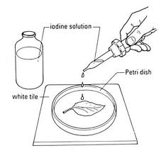
Life sciences Grade 11 CAPS structured, clear, practical - Helping teachers unlock the power of NCS
KNOWLEDGE AREA:
Life Process in Plants and Animals.
TOPIC 2: Photosynthesis
Photosynthesis:
A Practical Study

Slide 2
Summary of the presentation
The Importance of the Starch Test
The Importance of a Control in an Investigation
Developing a Test for Photosynthesis
Introduction

Slide 3
INTRODUCTION
Photosynthesis is the process by which plants manufacture their own food.
In order for the plants to make their own food they require energy.
The source of this energy is the sun.
Plants are the only organisms on earth that are able to absorb the sun’s energy.
They are able to do this because they posses a pigment called chlorophyll.
The chlorophyll is found in organelle in the plant cells called chloroplasts.

Slide 4
INTRODUCTION
Since plants that are able to manufacture their own food they are called producers.
However what we must remember is that some organisms like the bacteria are able to produce their own food but they do not have chloroplast or even chlorophyll!
Remember that the bacteria obtains the energy from certain chemical reactions and the process by which they manufacture food is called chemosynthesis.
They are also called producers.
Can anyone explain why?

Slide 5
solution
Because…
A producer is an organism that can manufacture its own food, however it does not have to produce the food through photosynthesis. Therefore bacteria that are able to produce their own food are called producers even though they do not manufacture their food by photosynthesis.

Slide 6
INTRODUCTION
Any organism that is unable to manufacture its own food is called a consumer.
In the next topic we shall look at these consumers.

Slide 7
INTRODUCTION
In this section we will deal with a large amount of practical work.
Therefore, before we look at the actual process of photosynthesis, lets get the theory of the practical out of the way.
We will look at the following:
The test for photosynthesis
The importance of the starch test
The control

Slide 8
The test for photosynthesis
The test for photosynthesis attempts to prove that photosynthesis has occurred by showing a presence of starch or glucose.
This test occurs in 3 broad steps.
These are:
We must ensure that the plant under investigation has no starch to start with. We need to remove all starch that is present in the plant. This is called destarching the plant.
Allow the plant to undergo photosynthesis.
Now test for the presence of starch that was produced during photosynthesis.

Slide 9
The test for photosynthesis
To destarch the plant:
For these experiments we use potted plants.
We place a potted plant in a dark cupboard for 2 to 3 days.
What happens here is that the plant cannot manufacture food because it is not exposed to sunlight.
Therefore it uses up all the starch that maybe stored in the cells.
Therefore after 2 to 3 days the plant should test negative for the presence of starch.

Slide 10
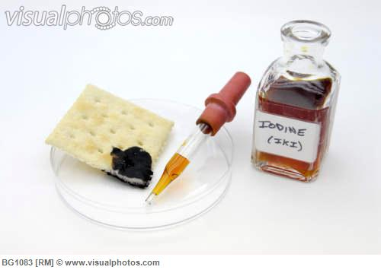
The test for photosynthesis
Test for Starch:
Once the plant has been destarched and after photosynthesis has occurred we need to prove that starch is present or that it is not.
To do this we use a chemical called iodine.
Iodine is a chemical reagent.
Iodine occurs in dark granules.
These granules are allowed to dissolve in some water to produce iodine solution.
Iodine solution has a dark brown colour.
Iodine granules and solution

Slide 11
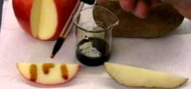
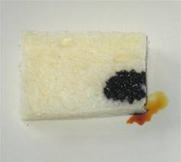
The test for photosynthesis
If the iodine is added to a substance that contains starch the iodine can turn in colour from blue, purple or even black.
The colour change depends on the amount of starch present.
If there is a lot of starch present then it turns almost black in colour.
If there is a small amount of starch present then it turns a dark blue colour.
The apple tests positive for starch but the
Iodine is not as dark as in the bread
because the bread contains more starch

Slide 12
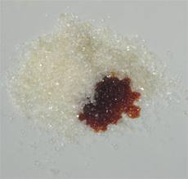
The test for photosynthesis
If starch is absent, as it will be in the destarched plant then the iodine remains brown.
Now you are able to test for the presence of starch.
Remember if starch is present in the leaves of the plant then photosynthesis has occurred.
These granules do not contain starch
therefore the iodine remains brown

Slide 13
The importance of the starch test
The starch test has the following value:
If the iodine turns blue black when added to a leaf then starch is present.
This means that photosynthesis has occurred.
If the iodine remains brown when added to the leaf then starch is not present.
This means that photosynthesis has not occurred.
This means that this test can be used to show that photosynthesis has or has not occurred.

Slide 14
The importance of the control
The function or purpose of a control is to verify the results of the experiment.
This means that control helps to make absolutely certain that the results of the experiment is due to the variable being tested.
It shows that the results of the experiment was only due to the factor being tested.
The factor being tested is called a variable.
The control is set up in exactly the same way as the experiment, BUT the variable being tested is removed.
Therefore in any investigation there are 2 sets of apparatus.

Slide 15
The importance of the control
One set is the experiment and the other is the control.
As mentioned earlier the 2 sets of apparatus have only 1 difference, that is…
In the experiment the variable being test is present while in the control it is not.
Then if the result of the experiment is positive while that of the control is not then we can conclude that the variable is the reason for the positive result.
Since the control is only different from the experiment because the variable is absent, then the positive result can only be because of the variable.

Slide 16
The importance of the control
However if there is more than 1 difference between the experiment and the control then the results of the experiment is not reliable.

Slide 17
Terminology:
Producer: organism that is able to produce its own food.
Chemosynthesis: process during which organisms uses energy obtained from certain chemical reactions to obtain their own food.
Photosynthesis: process during which green plants manufacture their own food using the radiant energy of the sun.
Chlorophyll: green pigment that gives the plant its green colour and is able to trap sunlight.
Chloroplast: is the organelle in which chlorophyll is found.
Destarch: is to remove all the starch form a plant by placing it in a dark cupboard for 2 to 3 days.

Slide 18
Terminology:
Iodine: chemical reagent that is used to test for the presence of starch.
Variable: the factor that is being tested in an investigation.
Control: is used to verify the results of an experiment.

Slide 19
Question 1
Factor being tested in an experiment is called…
A. Variable
B. Iodine
C. Factor
D. Ingredient

Slide 20
Question 2
In the presence of a starch iodine would turn…
A. White
B. Black
C. Green
D. Brown

Slide 21
Question 3
In the absence of starch iodine would remain…
A. White
B. Black
C. Green
D. Brown

Slide 22
Question 4
A control is different from the experiment in only ____ way.
A. 1
B. 2
C. 3
D. 4

Slide 23
Question 5
If the control and the experiment are different from each other in more than one way then…
A. The result of the experiment is valid.
B. The result of the experiment is valid that of the control is not.
C. The result of the experiment is not valid but the result of the control is.
D. The result of the experiment is not valid.

Slide 24
Question 6
The starch test proves that…
A. If starch is present then photosynthesis has occurred.
B. Presence of starch does not indicate that photosynthesis has occurred.
C. Photosynthesis has not occurred
D. The absence of starch is an indication that photosynthesis has occurred.

Slide 25
Question 7
A plant is destarched when its…
A. Placed in a dark cupboard for 2 or 3 days.
B. Placed in a cupboard for 2 or 3 days.
C. Left inside a room for 2 to 3 days.
D. None of the above.

Slide 26
SOLUTION TO FINAL ASSESSMENT QUESTIONS
A
B
D
A
D
A
A

