Slide 1
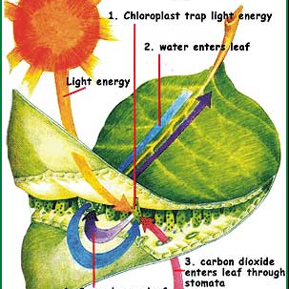
Life sciences Grade 11 CAPS structured, clear, practical - Helping teachers unlock the power of NCS
KNOWLEDGE AREA:
Life Process in Plants and Animals.
TOPIC 2: Photosynthesis
Photosynthesis:
The Process

Slide 2
Summary of presentation:
Structure of the Chloroplast
The Process of Photosynthesis
Factors affecting the Rate of Photosynthesis
Adaptations of the Leaves for Photosynthesis
Biological Importance of Photosynthesis
Greenhouse
Role of Carbon Dioxide Enrichment, Optimal Light, Temperature in Greenhouse Systems
Introduction

Slide 3
Introduction:
Photosynthesis is the process whereby green plants use the radiant energy of the sun to manufacture food in the form of glucose.
The process is a chemical reaction.
In order for this chemical reaction to occur, there are some requirements and at the end of the process some products are formed.
The requirements of photosynthesis are a source of energy (sunlight), carbon dioxide and water.
The products of this reaction are glucose.

Slide 4
Introduction:
Oxygen is produced as a by product.
These requirements and products maybe represented in the form of an equation.
This equation is as follows:
Carbon dioxide + water + energy → glucose + oxygen
CO₂+ H₂O + energy → C₆H₁₂O₆ + O₂

Slide 5
Structure of chloroplast
Since photosynthesis occurs in chloroplast, we must understand the structure of the chloroplast.
The chloroplast is surrounded on the outside by a double membrane.
This membrane allows carbon dioxide and water to enter the chloroplast.
Within the double membrane lies the ground substance called the stroma.
Embedded within the stroma are stacks of coin-like structures. Each coin-like structure is called the granum or many grana.

Slide 6
Structure of chloroplast
The granum is made up of membranes called the lamella.
Within the grana are structures called the thylakoids.
These thylakoids contain the pigment called chlorophyll.
The chlorophyll is used to trap sunlight.
Also found in the stroma are starch granules, ribosome and enzymes.
The starch granules are used to store starch.
Ribosomes are the site of protein synthesis, this means it is the place were enzymes are manufactured.
The enzymes are used for the dark phase.

Slide 7
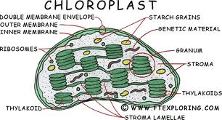
Structure of chloroplast

Slide 8
Something for you to do:
Look at the diagram on the previous slide and explain how the chloroplast is adapted for photosynthesis.

Slide 9
Solution:
The double membrane allows for water and carbon dioxide to enter the chloroplast.
Chlorophyll is present to trap sunlight.
The grana are large flat discs that offers a large surface to trap sunlight.
Ribosomes are present for the production of enzymes.
Enzymes are present in the stroma for the reactions of the dark phase.
Starch granules are used to temporarily store starch.

Slide 10
The process of photosynthesis:
The process can be divided into 2 phases:
These are the:
The light phase
The dark phase
The Light Phase:
This phase is dependent on light.
This means that if light is not present this phase will not occur.
Therefore it occurs in the presence of light.
This phase takes place in the grana of the chloroplast.

Slide 11
The process of photosynthesis:
Because the grana contain the chlorophyll.
The chlorophyll absorbs the radiant energy from the sun.
This radiant energy is used in 2 ways:
It is used to form ATP. ATP is an energy carrier. It stands for Adenosine Triphosphate.
The energy is also used to split the water molecule into hydrogen and oxygen.
These hydrogen atoms are high energy atoms. They combine with coenzymes that carry them to the dark phase.

Slide 12
The process of photosynthesis:
The oxygen is released into the atmosphere as a by-product.
The oxygen leaves the leaves through the stomata.

Slide 13
The process of photosynthesis:
The Dark Phase:
This phase is independent of light.
This means that it would occur whether light is present or not.
This phase occurs in the stroma.
The carbon dioxide provides the carbon and oxygen.
This carbon and oxygen combine with the hydrogen atoms of the light phase to form high energy carbohydrates such as glucose.

Slide 14
The process of photosynthesis:
This reaction requires a lot of energy.
The energy comes from the high energy hydrogen atoms and the ATP molecules.
The reactions of the dark phase are controlled by enzymes.

Slide 15
Factors affecting the rate of photosynthesis:
The rate of photosynthesis is affected by both external and internal factors.
INTERNAL FACTORS:
There are many internal factors that affect photosynthesis.
However we shall only look at the leaves.
If the leaves allow more light and carbon dioxide to enter then more photosynthesis will occur.
Similarly the rate of photosynthesis will decrease if less light and carbon dioxide enter the plant.

Slide 16
Factors affecting the rate of photosynthesis:
The following features will allow the leaf to absorb more sunlight and carbon dioxide and therefore increase the rate of photosynthesis.
Leaves that have large stomata therefore more carbon dioxide will enter the leaf.
Leaves that have many stomata, ensures more carbon dioxide enters the leaf.
Large intercellular spaces allows for the quick and easy movement of gases and water to the chloroplast.

Slide 17
Factors affecting the rate of photosynthesis:
A large amount of mesophyll tissue, therefore large number of chlorophyll. This ensures a maximum amount of sunlight will be absorbed.
The thin cuticle allows for the easy entry of light and therefore more light will enter the leaves.
The fewer or complete absence of epidermal hairs prevents the reflection of light and therefore more light will enter the leaf.

Slide 18
Adaptations of the leaves for photosynthesis:
The leaf is covered by a thin, transparent cuticle to allow the light to pass through to the deeper lying tissues easily.
The cuticle is waxy to reduce water loss by transpiration.
The epidermis is transparent to allow a lot of light to pass through.
The epidermis is only a single layer thick allowing light to pass to the deeper lying tissues more easily.

Slide 19
Adaptations of the leaves for photosynthesis:
The palisade mesophyll cells are elongated so that they are closely packed therefore more chlorophyll and more light would be absorbed.
The elongated cells allows for the deep penetration of light.
The palisade cells have thin cell walls to allow for the easy entry of carbon dioxide and water.
The spongy mesophyll cells have an irregular shape, this creates air spaces. These air spaces allow for gaseous exchange.

Slide 20
Adaptations of the leaves for photosynthesis:
The spongy mesophyll also has chloroplast to trap sunlight.
The cell walls are thin to allow for the easy entry of carbon dioxide and water.
Presence of xylem to transport water to the chloroplast.
The presence of phloem to transport the manufactured food to all parts of the plant from the leaves.
The lower epidermis has guard cells that contain chloroplast to trap sunlight.

Slide 21
Adaptations of the leaves for photosynthesis:
The guard cells has thick and thin cell walls to control the opening an closing of the stomata.
The stoma found between the guard cells allow carbon dioxide to enter and oxygen to leave the leaf.

Slide 22
External factors that affect the rate of photosynthesis:
The external factors that affect the rate of photosynthesis are…
Carbon dioxide concentration
Light intensity
Temperature

Slide 23
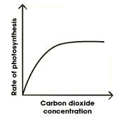
External factors that affect the rate of photosynthesis:
THE CO₂ CONCENTRATION
Normal CO₂ concentration in the atmosphere is 0,03%.
If the CO₂ concentration increases then the rate of photosynthesis would increase too, because CO_{2 is} one of the requirements of photosynthesis.
But if the CO₂ concentration remains high over a long period of time then the rate of photosynthesis remains constant.

Slide 24
External factors that affect the rate of photosynthesis:
This happens because the high level of CO₂ changes the pH in the cell and the enzymes can no longer work.
Therefore the rate of photosynthesis would remain the same (become constant).
The rate may also remain constant because there is not enough water or light.

Slide 25
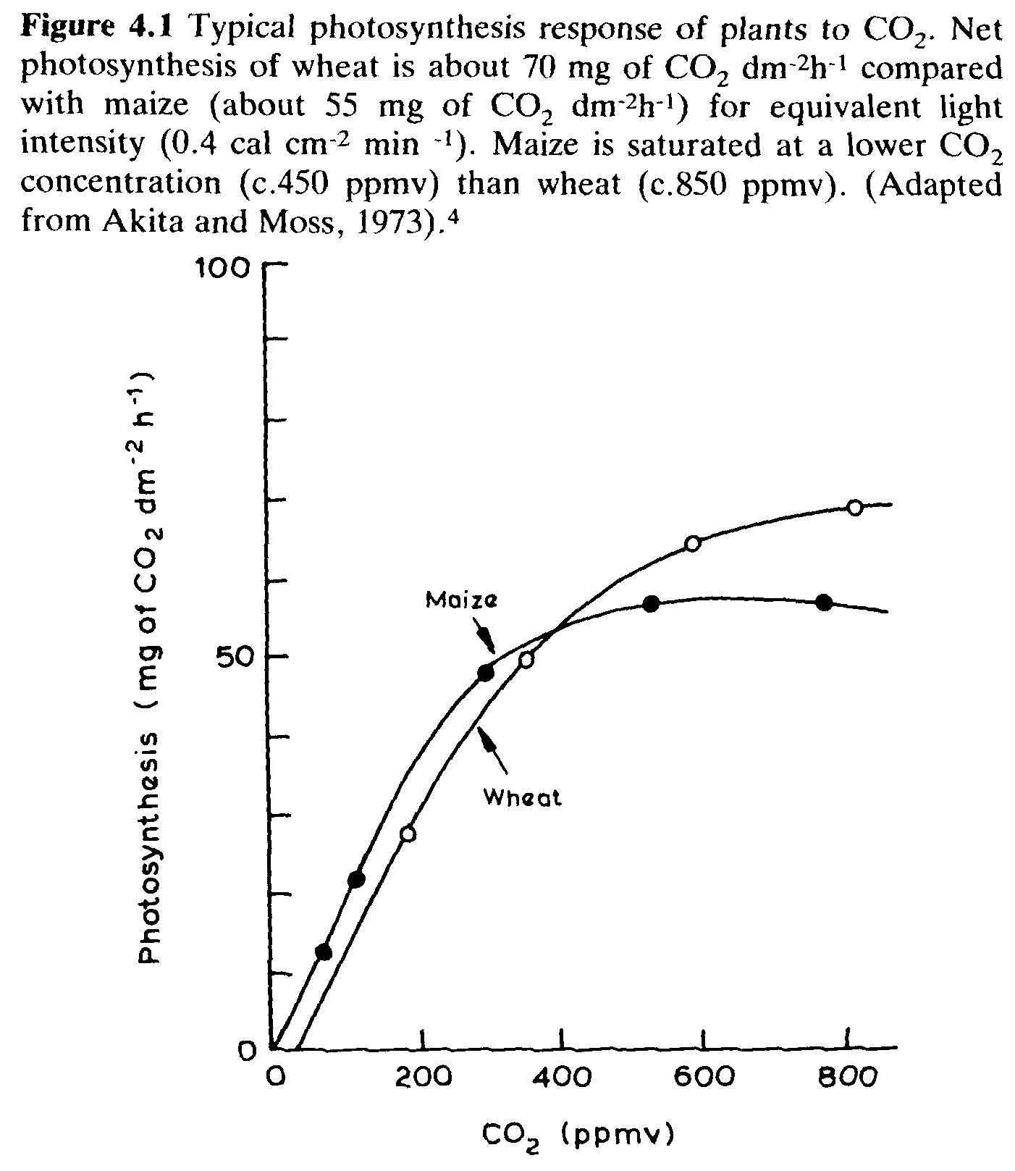
Something for you to do:
Study the graph alongside and answer the questions that follow:
Provide a suitable heading for the graph.
Name the dependent and independent variables.
What is the optimum CO₂ concentration for the maize plant?
Use the graph to explain the relationship between concentration and rate of photosynthesis.

Slide 26
Something for you to do:
Explain why the rate of photosynthesis does not continue to increase even though the CO₂ concentration does.

Slide 27
Solution:
The effect of increasing concentration on the rate of photosynthesis.
dependent – rate of photosynthesis; independent - CO₂ concentration
About 450ppmv
As the CO₂ concentration increase the rate of photosynthesis also increases, but it becomes constant and then appears to drop as the CO₂ concentration increases further.
The rate of photosynthesis does not increase any further because the levels of CO₂ in the cells becomes too high and this alters the pH and enzymes denature.

Slide 28
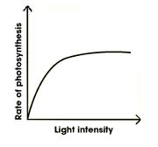
External factors that affect the rate of photosynthesis:
LIGHT INTENSITY:
According to the graph if the light intensity increases, so would the rate of photosynthesis.
If the light intensity decreases, so would the rate of photosynthesis.
Can anyone explain why?

Slide 29
SOLUTION:
Because light is one of the requirements of photosynthesis, therefore any change in light intensity would affect the rate of photosynthesis.

Slide 30
External factors that affect the rate of photosynthesis:
However from the graph we can see that the rate of photosynthesis does not increase indefinitely.
At a certain light intensity the rate of photosynthesis becomes constant.
This occurs because there might not enough carbon dioxide and water.

Slide 31
External factors that affect the rate of photosynthesis:
TEMPERATURE:
Photosynthesis in mesophytic plants have an optimum temperature.
This is the temperature at which the rate of photosynthesis is at its maximum.
The optimum temperature for photosynthesis in a mesophytic plant is 25˚C.

Slide 32
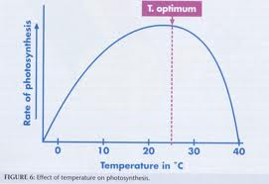
External factors that affect the rate of photosynthesis:
According to the graph, as the temperature increase so does the rate of photosynthesis.
It reaches its maximum rate at the optimum temperature.
If the temperature continues to increase higher than optimum temperature then the rate of photosynthesis decreases and finally stops all together.
Why?

Slide 33
Solution:
This happens because once the temperature becomes higher than optimum, the temperature is too high and the enzymes starts to denature. Therefore the rate of photosynthesis will decrease and eventually stop.

Slide 34
Biological importance of photosynthesis:
Photosynthesis has 2 areas of biological importance.
These are:
Provision of food/energy:
Green plants absorb radiant energy and uses it to make food through the process of photosynthesis.
In this way food is provided to all other organisms.
Also the radiant energy is transferred to all organisms that feed on the plant or on animals that feed on those animals that feed on the plant.
In this way all living organisms on Earth posses energy from the sun.

Slide 35
Biological importance of photosynthesis
Control of Carbon dioxide/oxygen levels:
All plants and animals take in oxygen for the process of cellular respiration.
Therefore the levels of O₂ in the atmosphere drops.
All plants and animals give off CO₂ during cellular respiration.
Remember that CO₂ is also given of during decomposition and the burning of fuels.
Therefore the levels of CO₂ in the atmosphere increase and become harmful.

Slide 36
Biological importance of photosynthesis
During photosynthesis CO₂ is required.
Therefore the plant absorbs the excess CO_{2.}
This causes the level of CO₂ in the atmosphere to drop to normal.
During photosynthesis O₂ is given off.
This increases the levels of O₂ in the atmosphere back to normal.
Therefore photosynthesis ensures that the level of CO₂ and O₂ in the atmosphere is always constant.

Slide 37
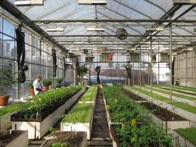
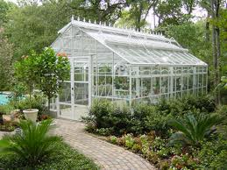
Greenhouse:
A greenhouse is a building in which plants are grown.
These plants will not usually grow in that area or season.
The green house is made up of glass or layers of polyethylene.
Polyethylene is a special type of plastic.
Greenhouses

Slide 38
Greenhouse:
The greenhouse works in the following way:
The glass walls and ceiling allows light to enter.
At the same time cold air and pests to the plant ( such as birds, bugs etc) are kept out.
By providing the plant with water, fertilizer, good air flow and heat the plant can grow in any season and climate.
In large commercial greenhouses special equipment and trained staff are available to ensure the correct amount of water, fertilizer, good air flow and heat are available to the plant at all times.
Remember the mentioned factors will affect the rate of photosynthesis and cellular respiration and therefore the growth of the plant.

Slide 39
Role of CO₂ enrichment, optimal light & temperature in greenhouse systems
We already know that light, temperature and concentration affect the rate of photosynthesis.
Therefore if these factors increase or decrease the rate of photosynthesis will change accordingly.
In a greenhouse these factors can be controlled according to needs these of the plant.
For example:
If it is too bright then shade cloths may used to reduce light entering.

Slide 40
Role of CO₂ enrichment, optimal light & temperature in greenhouse systems
If there is not enough light then artificial light maybe added.
Temperature can be altered by using heaters to increase temperature or fans to decrease temperature.
The carbon dioxide concentration can be increased by pumping in compressed CO_{2.}

Slide 41
Terminology:
Photosynthesis: is the process whereby a green plant uses the radiant energy of the sun to manufacture food in the form of glucose.
Granum: coin-like structure that contains chlorophyll.
Chloroplast: organelle that contains chlorophyll.
Chlorophyll: green pigment that traps sunlight and gives the plant its green colour.
Stroma: ground substance of chloroplast
Light phase: the reactions of photosynthesis that can only occur in the presence of light.

Slide 42
Terminology:
Dark phase: the reactions of photosynthesis that is independent of light.
Greenhouse: a building made up entirely of glass or polyethylene that is used to grow plants all year round.
Polyethylene: is a special type of plastic used to make greenhouses.

Slide 43
Question 1
The requirements for photosynthesis are…
A. CO_{2,} light, water
B. O₂ and glucose
C. Light, water and glucose
D. CO₂ and glucose

Slide 44
Question 2
The products of photosynthesis are…
A. CO_{2,} light, water
B. O₂ and glucose
C. Light, water and glucose
D. CO₂ and glucose

Slide 45
Question 3
The by product of photosynthesis is…
A. CO₂
B. O₂
C. glucose
D. water

Slide 46
Question 4
The leaf is adapted to absorb sunlight because it contains…
A. Chromoplasts
B. Leucoplasts
C. Chloroplasts
D. Amyoplasts

Slide 47
Question 5
The pigment that is responsible to absorb sunlight is…
A. Haemoglobin
B. Melanin
C. Both A and D
D. Chlorophyll

Slide 48
Question 6
The glucose that is made during photosynthesis is stored as…
A. Starch granules
B. Ribosomes
C. Enzymes
D. chlorophyll

Slide 49
Question 7
The small round body found in the chloroplast that is involved in the production of enzymes is…
A. Starch granules
B. Ribosomes
C. Enzymes
D. Chlorophyll

Slide 50
Question 8
The protein molecule that is used to speed up chemical reactions without being used in the reaction is…
A. Starch granules
B. Ribosomes
C. Enzymes
D. Chlorophyll

Slide 51
Question 9
The ground substance of the chloroplast is called…
A. Stroma
B. Stoma
C. Granum
D. Lamella

Slide 52
Question 10
The stacks of coin-like structures found in the chloroplast are called…
A. Stroma
B. Stoma
C. Granum
D. Lamella

Slide 53
Question 11
Each coin-like structure is made up of membranes called…
A. Stroma
B. Stoma
C. Granum
D. Lamella

Slide 54
Question 12
The 2 phases of photosynthesis are…
A. Light phase and dark phase
B. Light phase and Krebs cycle
C. Dark phase and Krebs cycle
D. None of the above

Slide 55
Question 13
The difference between the light and dark phase is…
A. The light occurs only in the day and the dark phase occurs in the night.
B. The light phase is independent of light while the dark phase is dependent on light.
C. The light phase is dependent on light and the dark phase is independent of light.
D. The light phase is dependent on light and the dark phase can only occur in the day.

Slide 56
Question 14
During photosynthesis the light energy is used …
A. To form ATP
B. To split the water molecule
C. To make oxygen
D. Both A and B

Slide 57
Question 15
The energy required for the dark phase comes from…
A. High energy H atoms and ATP
B. Sunlight and ATP
C. Enzymes and ATP
D. Enzymes and coenzymes

Slide 58
Question 16
The substance that transfers the high energy H atoms of the light phase to the dark phase is…
A. Enzyme
B. Coenzyme
C. ATP
D. None of the above

Slide 59
Question 17
The part of the chloroplast where the ATP is produced during photosynthesis is…
A. Grana
B. Stroma
C. Ribosome
D. Starch granule

Slide 60
Question 18
Name the part of the chloroplast that will only be active in light…
A. Grana
B. Stroma
C. Ribosome
D. Starch granule

Slide 61
Question 19
The rate of photosynthesis will increase if…
A. CO₂ concentration increase and light intensity decreases.
B. CO₂ concentration increases and the stomata are closed.
C. CO₂ concentration decreases and stomata are opened.
D. CO₂ concentration increases and stomata are opened.

Slide 62
Question 20
The following internal factors will decrease the rate of photosynthesis…
A. Low CO₂ concentration and low light intensity.
B. Thick cuticle and closed stomata.
C. High CO₂ concentration and closed stomata.
D. High light intensity and closed stomata.

Slide 63
Solution:
A
B
B
C
D
A
B
C
A
C
D
A
C
D
A
B
A
A
D
B

