Slide 1
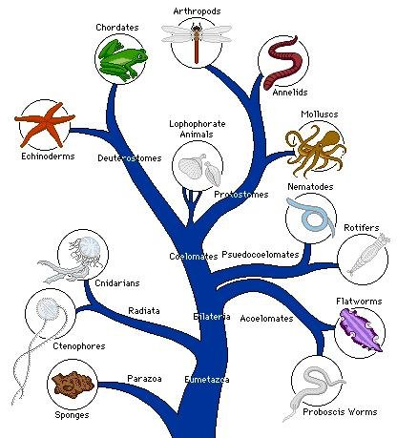
Life sciences Grade 11 CAPS structured, clear, practical - Helping teachers unlock the power of NCS
KNOWLEDGE AREA: Diversity, change and continuity
TOPIC 1: Biodiversity of Animals
Diversity of Animals

Slide 2
Summary of presentation
Phylum Porifera
Phylum Cnidaria
Phylum Platyhelminthes
Phylum Annelida
Phylum Arthropoda
Phylum Chordata
Relationship between Body Plan and Modes of Living
Role of invertebrates in agriculture & ecosystems

Slide 3
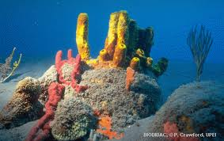
Phylum Porifera
This phylum is made up of natural sponges.
These are living animals .
They vary in size from a few millimeters to a few meters.
They can be brightly coloured.
Colourful sponges

Slide 4
Phylum Porifera
HABITAT:
These are aquatic animals.
This means that they live in water.
They live in both fresh water and in salt water.
Therefore some species are fresh water and others are marine.
They are sedentary animals meaning that they do not move.
They are attached to rocks and other objects that are found under the water, we say that these objects are submerged.

Slide 5
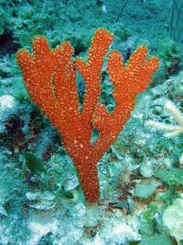
Phylum Porifera
STRUCTURE:
Sponges have an irregular shape.
What type of symmetry would they have?
Can you describe this symmetry?
Irregular shape of
Sponges

Slide 6
Phylum Porifera
They are asymmetrical.
This means that they can not be cut into 2 identical halves. In other words they do not have any symmetry.
Their body wall is made up of 2 layers.
These 2 layers are an outer epidermis and an inner layer of cells.
These 2 layers are separated by a mesophyll.
The mesophyll, is a non cellular jellylike layer.
However these 2 layers of cells are not considered to be true tissues because they are not separated by membranes.

Slide 7
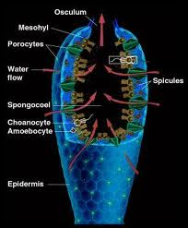
Phylum Porifera
Sponges do not have any digestive openings.
They have the following structure:
They are surrounded by an epidermis.
The epidermis has pores on it.
These pores lead to a central cavity .
This central cavity is called the spongocoel.
Photo of Sponges showing
internal and external structure

Slide 8
Phylum Porifera
The sponge does not have a coelom, but the term coelom must only used in triplobalstic animals.
Therefore sponges cannot be called acoelomate.
We simply say that they do not have a body cavity.

Slide 9
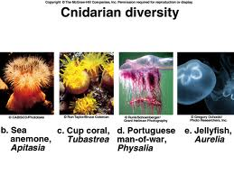
PHYLUM CNIDARIA
Jelly fish, blue bottles, sea anemones and corals all belong to this phylum as shown in the diagram belong.

Slide 10
PHYLUM CNIDARIA
HABIT AND HABITAT:
These are aquatic animals.
They are mainly marine but some do occur in fresh water.
Some organisms belonging to this phylum are sedentary for their entire lifecycle for example the sea anemone and hydra.
Others are free swimming for their entire lifecycle.
Still some species live a part of their lifecycle as sedentary and the rest of their lifecycle as free-swimming.

Slide 11
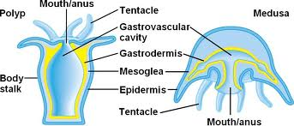
PHYLUM CNIDARIA
STRUCTURE:
These organisms show radial symmetry, whether they are free swimming or sedentary.
They have a single digestive opening.
It serves as both the mouth and anus.
This digestive opening occurs on the free end of sedentary stage and on the underside of the free swimming stage.

Slide 12
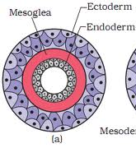
PHYLUM CNIDARIA
All forms of cnidarians are diploblastic.
They have an outer ectoderm and an inner endoderm.
These layers are separated from each other by a non-cellular jelly-like layer called the mesoglea.
Diagram showing the diploblastic
condition of Cnidarians.

Slide 13
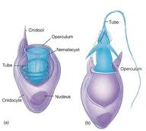
PHYLUM CNIDARIA
The ectoderm and endoderm are made up of many different types of cells.
The general function of all the ectodermal cells is to detect stimuli such as food or danger.
The ectoderm also contains a special type of cell called the cnidocytes or stinging cells.
They are involved in defence and the capture of prey.
Stinging cell or cnidocytes

Slide 14
PHYLUM CNIDARIA
The endodermal cells are involved in digestion and absorption of food.
These organisms do not have a body cavity.
Can you explain why we do not call them acoelomate?

Slide 15
SOLUTION:
Since the Cnidarians are diploblastic they cannot be called acoelomate because only the triploblastic organisms are considered to have coeloms.

Slide 16
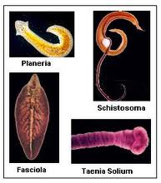
Phylum platyhelminthes
The organisms belonging to this phylum are also called flatworms.
This is so because their bodies are dorso-ventrally flattened.
This means that they are flattened from top to bottom.
Some examples of organisms that are found in this phylum are free living planarians and parasitic forms such as tapeworms.

Slide 17
Phylum platyhelminthes
HABIT AND HABITAT:
These organisms can be free living or parasitic.
Some of the free living forms are aquatic.
They may live in either fresh water or marine.
Other free living organisms are terrestrial, they live in damp environments.
The parasitic forms live in or on vertebrates.
Some of the parasitic forms require a secondary host.
This secondary host maybe either a vertebrate or invertebrate.

Slide 18
Phylum platyhelminthes
STRUCTURE:
They show cephalisation.
This has led to all forms displaying a definite anterior and posterior ends.
In most species there is dorso-ventral differentiation.
However in some species like the tapeworm both the sides look the same.
Since the show dorso-ventral differentiation and cephalisation they show bilateral symmetry.

Slide 19
Phylum platyhelminthes
They have only one digestive opening.
Their tissue developed from 3 germ layers, therefore they are triploblastic.
They do not have a coelom within the mesoderm. Therefore they are called acoelomate.
The free living flatworms have digestive tracts with many branches. This makes it possible to carry food throughout the animal.
The parasitic flatworms have a very poorly developed digestive tract.

Slide 20
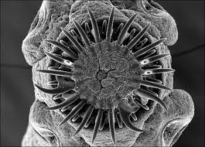
Phylum platyhelminthes
The parasitic flatworms have hooks and suckers to attach them firmly to the host.
The free living flatworms has no need for a transport system because food is carried to all parts of the body by the branched digestive tract.
Hooks
Suckers
Hooks and suckers of parasitic
flatworm

Slide 21
Phylum platyhelminthes
The parasitic flatworm does not need a transport system because it obtains food from the host throughout its body, then simple diffusion is sufficient to transport substances over short distances because the animal is flattened.
The flattened form of the organism makes diffusion an adequate means of transport for gases, because all the cells are in close contact with each other and the surface.

Slide 22
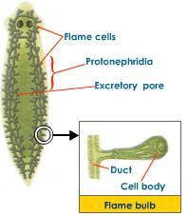
Phylum platyhelminthes
However the flatworms have a simple excretory system to get rid of metabolic waste.
This excretory system is made up of a network of flame cells.
Flame Bulb

Slide 23
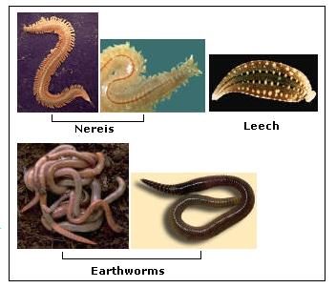
Phylum annelida
These organisms are also referred to as segmented worms.
The annelids are different from other worms because of their segments.
This phylum includes the marine bristle worms, leeches and earthworms.
A selection of organisms belonging
to this phylum

Slide 24
Phylum annelida
HABITAT AND HABIT:
This phylum has both aquatic and terrestrial organisms.
The aquatic organisms maybe either fresh water or marine.
The terrestrial organisms (earthworms) are found in moist soil.
Most are free-living, while others are parasitic.
The parasites are found attached to the outside of the host.
Therefore they are called ecto-parasites.
A good example is the leech that attaches itself to the outside of the host and suck their blood.

Slide 25
Phylum annelida
STRUCTURE:
All the organisms, whether they are parasitic or free living, show cephalisation and dorso-ventral differentiation.
Therefore they will all be bilaterally-symmetrical.
They are also triploblastic and coelomate.
Remember that triploblastic means that the tissues arose from 3 germ layers.
Therefore the epidermis, cuticle and nervous system arose from the ectoderm.

Slide 26
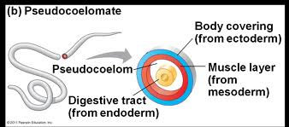
Phylum annelida
The gut wall arose from the endoderm.
All other tissues and organs such as the muscles, blood vessels and the excretory organs arose from the mesoderm.
The presence of the coelom means that the gut wall is too far away from the body wall.

Slide 27
Phylum annelida
Therefore diffusion can no longer be used to transport gases, food and excretory waste.
To overcome the problem of the transport of gases to and from the skin, a blood system has been developed.
The blood system transports the gases from the skin to the rest of the body.
The skin is the gas exchange surface.
The blood system is also used to transport food from the gut wall to the body wall.
An excretory system was evolved to transport the nitrogenous waste from the internal organs to the body surface.

Slide 28
Phylum annelida
The organisms have 2 digestive openings.
These are the mouth and anus.
Such a gut with 2 openings is called a through gut.
A through gut has the following advantages:
There is no mixing of digested, undigested food and partially digested, because the food travels in one direction only.
This allows for specialization of the gut, this means that different parts of the gut become adapted for different functions.
Now digestion can occur all the time, even while ingestion and egestion occurs.

Slide 29
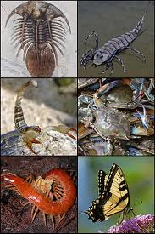
Phylum Arthropoda
This is a very large phylum, with extremely large number of species. (1 000 000).
Here are some examples in the picture alongside.
A selection of Arthropods

Slide 30
Phylum Arthropoda
From the previous slide we can see that the phylum includes the following organisms:
Chilapods-centipedes
Diplopods-millipedes
Crustaceans-crabs and crayfish
Arachnids-spiders and scorpions
Insects-bees, butterflies etc.

Slide 31
Phylum Arthropoda
HABIT AND HABITAT:
There are both aquatic and terrestrial organisms in this phylum.
The aquatic organisms occur in both fresh water and marine.
The terrestrial organisms may occur in the soil, on the surface of the soil and are even able to fly.
Some are free living while others are parasitic.

Slide 32
Phylum Arthropoda
STRUCTURE:
These organisms show cephalisation and dorso-ventral differentiation.
Therefore they are bilaterally symmetrical.
They have a through gut.
They are also triploblastic and coelomate.
The epidermis, the exoskeleton, the nervous system and sense organs all arise from the ectoderm.
The gut wall is of endodermal origin.
The muscles, blood vessels, reproductive organs all arise from the mesoderm.

Slide 33
Phylum Arthropoda
The coelom is much smaller when compared to the coelom of organisms in the previous phyla.
The coelom no longer functions as a hydrostatic skeleton because arthropods have exoskeletons.
The coelom contains the reproductive organs.
The coelom also gives rise to the haemocoels.
The haemocoel is a blood filled cavity.

Slide 34
SOMETHING FOR YOU TO DO
Can you identify the type of blood system that the arthropods have? Substantiate your answer.

Slide 35
Solution:
It has an open blood system, because the blood flows in blood vessels for only a short period of time. The blood vessels open into the haemocoels.

Slide 36
Phylum Arthropoda
The most significant feature of the arthropods is the presence of an exoskeleton.
The exoskeleton is secreted by the epidermis.
It is a non-living cuticle.
The exoskeleton is made up of layers of protein.
This protein is called chitin.
Chitin is leathery but becomes hard when calcium chloride is embedded in it.
Calcium chloride is a salt.

Slide 37
Phylum Arthropoda
ADVANTAGES OF THE EXOSKELETON:
It protects the animal against mechanical injury.
The muscles are attached to the exoskeleton. The exoskeleton provides a strong surface against which the muscles contract and relax. The muscles work antagonistically to bring about movement. What does this mean?
It prevents desiccation.

Slide 38
Solution:
The word antagonistically means that pairs of muscles work in opposition to each other.
This means that when one muscle contracts the other relaxes.

Slide 39
Phylum Arthropoda
DISADVANTAGES OF THE EXOSKELETON:
The skin can no longer be used as a gas exchange surface, because the exoskeleton is impermeable. Therefore new gas exchange organs become necessary.
The exoskeleton cannot stretch to accommodate the growth of the animal. This problem is overcome by moulting. During moulting the exoskeleton is shed, then a new exoskeleton is secreted. This exoskeleton is soft and flexible for a while, during this time the animal grows.

Slide 40
Phylum ArthropodA
The soft exoskeleton does not offer protection and the exoskeleton is so soft that the muscles are unable to contract and relax, therefore the animal is unable to move. Therefore the animal must live in burrows and crevices until the exoskeleton hardens.
The exoskeleton has limited the size of the arthropod because if the animal where to be very large the exoskeleton would be very large and bulky, making locomotion difficult.

Slide 41
Phylum ArthropodA
Arthropods can be identified by…
the presence of an exoskeleton and jointed appendages. The appendages need to be jointed to allow for movement because of the hard exoskeleton.
Their body is divided into 3 regions, these are the head, thorax and abdomen.
They all have 3 pairs of legs.

Slide 42
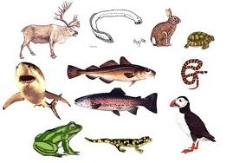
Phylum chordata
The organisms in this phylum all have a dorsal rod and a hollow nerve tube or spinal cord.
The dorsal rod is called a notochord.
A notochord is a flexible rod-like structure found in all chordates.
It is of mesodermal origin.
Some examples of Chordates

Slide 43
Phylum chordata
The chordates show cephalisation and dorso-ventral differentiation.
Therefore they are bilaterally symmetrical.
They are also triploblastic and coelomate.
They have a through gut.
The vertebrates are one example of organisms belonging to this phylum.
The vertebrates are characterized by a vertebral column and an endoskeleton.
The endoskeleton is an internal skeleton.

Slide 44
Phylum chordata
This endoskeleton maybe made up of either bone or cartilage.
The vertebrates maybe endothermic or ectothermic.
Endothermic refers to organisms who are able to maintain a constant internal body temperature irrespective of changes that may occur in the external environment.
Ectothermic refers to those organisms whose body temperature changes with the temperature of the environment.

Slide 45
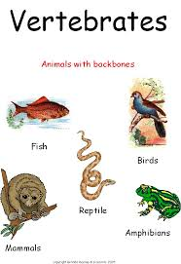
Phylum chordata
The phylum chordata is made up of the following groups:
Osteichthyes (bony fish)
Chondrichthyes (cartilaginous fish)
Amphibia (frogs)
Reptilia (snakes and lizards)
Aves (birds)
Mammalia (mammals)
Only the birds and mammals are endothermic.
The others are all ectothermic.

Slide 46
Relationship between body plan and modes of living
THE PORIFERA:
Remember these organisms are sedentary and aquatic. Therefore there is no need for cephalisation because it does not go into new areas.
Since it does not show cephalisation it would not be bilaterally symmetrical.
These organisms have an irregular shape therefore the would be no symmetry.

Slide 47
Relationship between body plan and modes of living
The Porifera feeds by pores that are found all around its body wall.
It is a filter feeder, tiny particles that are suspended in the water enter the body through the pores. Therefore there is no need for digestive openings.
Since the pores are found all around the body wall there is no need for accumulation of sense organs. This means that radial symmetry is unnecessary.

Slide 48
Relationship between body plan and modes of living
Now we can see that they are simple organisms and have no need for specialization, they are made up of only 2 germ layers, they are diploblastic.
Now remember that this organism has only 2 body layers, therefore it does not have a coelom. Remember we can’t even call the organism an acoelomate! Do you remember why?
Diffusion is an adequate means of transport for food and waste substances because all the cells of the ectoderm and endoderm are in direct contact with the water. Making the presence of a transport system unnecessary.

Slide 49
Relationship between body plan and modes of living
THE CNIDARA:
The cnidarians can be sedentary or free swimming.
They have a single digestive open.
This opening serves as both the mouth and anus.
These organisms show radial symmetry because their. mouth is centrally situated with the tentacles all around it.
They are very simple organisms with no need for specialization, therefore they are diploblastic.

Slide 50
Relationship between body plan and modes of living
Since they are diploblastic they are unable to have a coelom because of the absence of the mesoderm.
A transport system is unnecessary because all the cells of the ectoderm and endoderm are in direct contact with the water. This makes diffusion an adequate means of transport.

Slide 51
Relationship between body plan and modes of living
THE PLATYHELMINTHES:
These organisms have only 1 digestive opening that serves as both the mouth and the anus.
The dorsal and ventral sides of the free-living forms are different, therefore they show dorso-ventral differentiation. These free-living forms have “eyes” on their dorsal surface.
Since these organisms move they come into contact with new areas with new dangers all the time, they need cephalisation.

Slide 52
Relationship between body plan and modes of living
Since they show dorso-ventral differentiation and cephalisation they will be bilaterally symmetrical.
Since these organisms move, they require muscles. Muscles remember arise from the mesoderm. Therefore the organism has 3 germ layers and is called triploblastic.
Even though they are triploblastic they still do not have a coelom. They are therefore called acoelmate.
There absence of a coelom means that diffusion is still an adequate means of transport because the cells of the ectoderm, mesoderm and endoderm are still in close contact with each other.

Slide 53
Relationship between body plan and modes of living
THE ANNELIDA, ARTHROPODA & CHORDATA:
These organisms eat a variety of foods. Therefore they need a very specialized digestive system. One in which different parts are adapted for different functions.
In order for this to happen, the digested, undigested and partially digested food must not mix.
Therefore these organisms would require 2 digestive opens so that food travels in 1 direction only.
These organisms therefore have a through gut.

Slide 54
Relationship between body plan and modes of living
They also show dorso-ventral differentiation, with “eyes” on their dorsal surfaces.
These organisms are quite active. They move in and out of new areas, therefore they need an accumulation of sense organs at one end of the body. So that they will be aware of dangers and sources of food when they enter a new environment.
Therefore they show cephalisation.
The presence of cephalisation and dorso-ventral differentiation results in the organisms being bilaterally symmetrical.

Slide 55
Relationship between body plan and modes of living
Since the move they require muscles.
Since muscles are of mesodermal origin they have 3 germ layers and are therefore called triploblastic.
For effective functioning of the muscles the gut walls need to function independently of the body wall.
A coelem was able to separate the body wall from the gut wall.
Therefore these organisms are coelomate.

Slide 56
Relationship between body plan and modes of living
Diffusion is no longer an adequate means of transport because the gut wall and body walls are no longer in close contact.
A blood system is necessary in these organism.
They also posses an excretory system or organs.

Slide 57
Role of invertebrates in agriculture & ecosystems
Insects such as bees, butterflies and moths pollinate flowers.
Earthworms act as decomposers. Not only do they get rid of dead and decaying matter, they release many important nutrients back into the soil and air, so that they can be reused by other plants and animals. Therefore they help with nutrient recycling.
The earthworm also helps to aerate the soil as it burrows in the soil.

Slide 58
Role of invertebrates in agriculture & ecosystems
During feeding the earthworm ingests a lot of soil with the leaves. The undigested material that leaves the worm through the anus is called casts.
These casts also enrich the soil.
Arthropods are ectoparasites on many vertebrates including humans. For example ticks on dogs and lice on humans.
Some insects acts as vectors.
A vector is an insect that carries a disease causing organism from one host to the next without it becoming infected itself.

Slide 59
Role of invertebrates in agriculture & ecosystems
For example the Anopheles mosquito carries the Plasmodium from human to human causing malaria or the tsetse fly carries Trypanosoma from one human to another, this protist causes sleeping sickness.
The arthropods also act as secondary or intermediate hosts.
Other examples of insect which act as vectors are:
House flies spread many common diseases for example: conjunctivitis, polio, TB, typhoid etc by carrying the pathogen from 1 human to another.
Flies also act as intermediate hosts for parasitic tapeworms and roundworms that cause diseases in poultry and horses.

Slide 60
Role of invertebrates in agriculture & ecosystems
Ticks are able to spread tick bite fever from 1 human to the next by transferring the bacterium causing the disease.
Cockroaches can carry many different types of pathogens.
Among them are bacteria like salmonella, staphylococcus and streptococcus and even viruses like the polio virus.
These pathogen survive in the cockroach’s digestive system for a very long time (months; years).
The pathogens are then passed out with the cockroach's droppings.
Humans become sick when they eat food that is contaminated by the cockroach droppings.

Slide 61
TERMINOLOGY:
Aquatic animals: animals that they live in water.
Fresh water organisms: are those that live in fresh water of rivers, lakes and dams.
Marine organisms: these are organisms that live in the salt water of the oceans.
Medusa: name given to the free swimming stage of the Cnidarian.
Polyp: name given to the sedentary stage of the Cnidarian.
Haemocoel: is a blood filled cavity found in arthropods.

Slide 62
TERMINOLOGY:
Moulting: shedding of the exoskeleton.
Endoskeleton: an internal skeleton made up of bone or cartilage.
Endothermic organisms: are organisms who are able to maintain a constant internal body temperature irrespective of changes that may occur in the external environment.
Ectothermic organisms: are organisms whose body temperature changes with the temperature of the environment.
Vector: is an insect that carries a disease causing organism from one host to the next without it becoming infected itself.

Slide 63
QUESTION 1
The gut of the cnidarian is called…
A. Coelom
B. Body cavity
C. Coelenteron
D. Both A and B

Slide 64
QUESTION 2
Which of the following apply to both the Porifera and Cnidaria…
A. Radial symmetry
B. Mesoglea
C. Hydrostatic skeleton
D. mesophyl

Slide 65
QUESTION 3
Which applies to Cnidarians only?
A. Diploblastic
B. Mesohyl
C. Spongocoel
D. Epidermis

Slide 66
QUESTION 4
Which applies to sponges only…
A. Mesoglea
B. Mesohyl
C. Coelenteron
D. Cnidocytes

Slide 67
QUESTION 5
Organism that have an irregular shape will be…
A. Radially symmetrical
B. Bilaterally symmetrical
C. Asymmetrical
D. None of the above

Slide 68
QUESTION 6
Sedentary means…
A. The organism remains attached to its substrate
B. Moves a lot
C. Only moves in water
D. Moves only on land

Slide 69
QUESTION 7
The central cavity of sponges are called…
A. Coelom
B. Coelenteron
C. Mesohyl
D. spongocoel

Slide 70
QUESTION 8
A through gut is a gut with…
A. One opening only
B. Two openings
C. A mouth only
D. An anus only

Slide 71
QUESTION 9
A marine bristle worm belongs to the phylum…
A. Cnidaria
B. Annelida
C. Chordata
D. Platyhelminthes

Slide 72
QUESTION 10
An organism that shows cephalisation and dorso-ventral differentiation will be…
A. Asymmetrical
B. Radially symmetrical
C. Bilaterally symmetrical
D. Both B and C

Slide 73
QUESTION 11
The advantage of a through gut is that…
A. Diffusion can be used for transport.
B. Specialization of the gut will occur.
C. There is mixing of digested, partially digested and undigested food.
D. Food does not travel in one direction

Slide 74
QUESTION 12
The coelom is a body cavity found only in…
A. Triploblastic organisms
B. Diploblastic organisms
C. Sea anemone
D. A and C

Slide 75
QUESTION 13
Segmented worms belong to the phylum…
A. Arthropoda
B. Chordata
C. Platyhelminthes
D. Annelida

Slide 76
QUESTION 14
Organisms with exoskeleton belongs to the phylum…
A. Arthropoda
B. Chordata
C. Platyhelminthes
D. Annelida

Slide 77
QUESTION 15
Organisms that are triploblastic but has no coelom belong to the phylum…
A. Arthropoda
B. Chordata
C. Platyhelminthes
D. Annelida

Slide 78
QUESTION 16
The exoskeleton is made up of layers of…
A. Protein
B. Carbohydrate
C. Fat
D. None of the above

Slide 79
QUESTION 17
Very active organisms that move a lot must have…
A. Cephalisation and coelom
B. Cephalisation and no coelom
C. No coelom and no cephalisation
D. Muscles and no coelom

Slide 80
QUESTION 18
An organism with a centrally situated mouth should be…
A. Asymmetrical
B. Radially symmetrical
C. Bilaterally symmetrical
D. None of the above

Slide 81
QUESTION 19
Organisms that have “eyes” on their upper surface show…
A. Dorso-ventral differentiation
B. Dorso-ventrally flattened
C. Cephalisation
D. No symmetry

Slide 82
QUESTION 20
A reptile is…
A. Asymmetrical, diploblastic and acoelomate
B. Symmetrical, triploblastic and acoelomate
C. Symmetrical, triploblastic and coelomate
D. Bilaterally symmetrical, triploblastic and coelomate

Slide 83
SOLUTIONS TO FINAL ASSESSMENT QUESTIONS
C
C
A
B
C
A
D
B
B
C
B
A
D
A
C
A
A
B
A
D

